Slide 1

YAM
Youth Aware of Mental Health

Slide 2
ARPA

Slide 3
ARPA-YAM
American Rescue Plan Act 2022
Youth Aware in Mental Health
Part of the Texas Child Mental Health Consortium Care, SB-11
  A Texas wide initiative to improve Mental Health for Children and Adolescents
Supported by ARPA (American Rescue Plan Act), SB-8

Slide 4
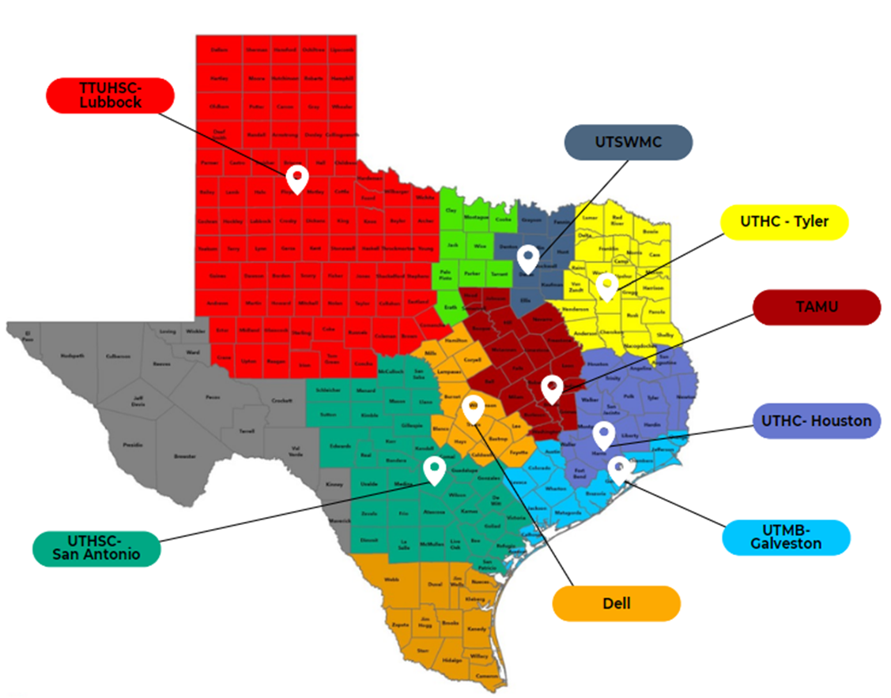
ARPA-YAM Network

Slide 5
YAM
Program
History

Slide 6
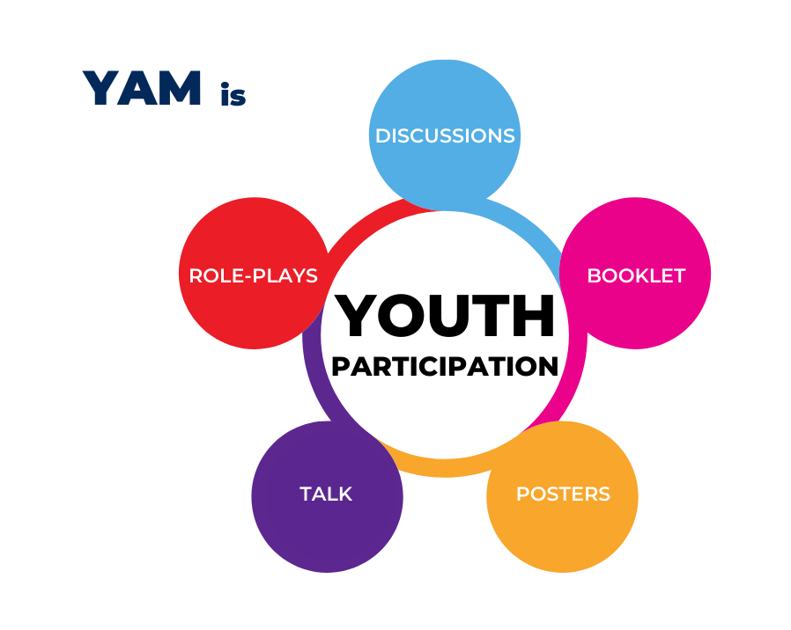
Evidence-based program delivered by certified facilitators to students in the classroom setting
5-session interactive mental health promotion program
Encourages
    - Discussion and participation
    - Increased knowledge and
    awareness of mental health in
    adolescents
    - Development of problem-solving
    skills and emotional intelligence
YOUTH AWARE OF MENTAL HEALTH

Slide 7

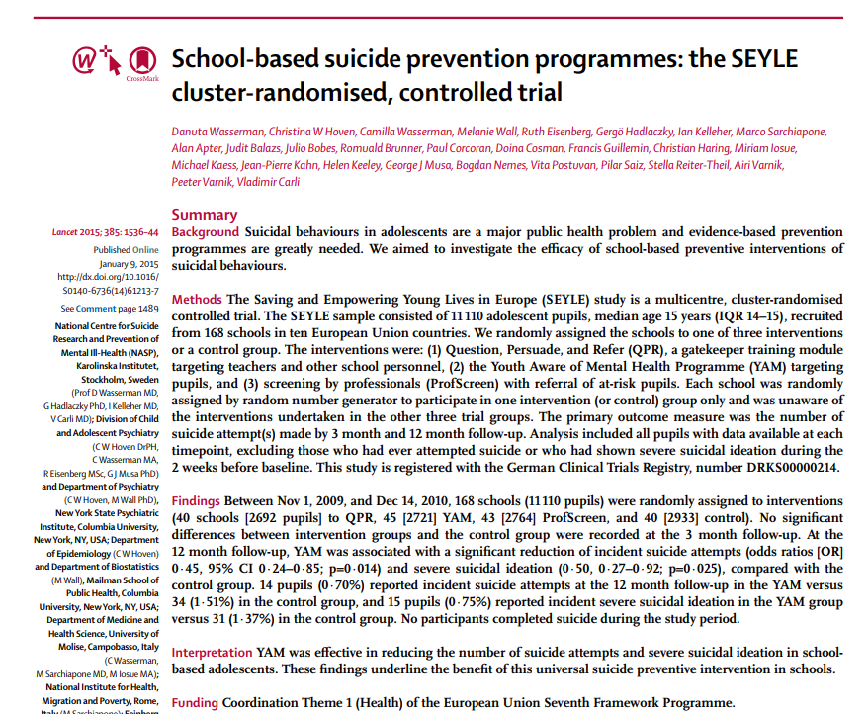
Lancet 2015
One of the Best Journals in Medicine
11,110 Students across Europe
Austria
Estonia
France
Germany
Hungary
Ireland
Italy
Romania
Slovenia
Spain
12 reported suicidal ideation in the YAM Group
vs
34 in the Control Group

Slide 8
Developed and tested in large research study
Evaluated effectiveness of different interventions for addressing mental health and suicide prevention in schools
YAM
  - more effective than other
  interventions improving
  adolescent mental health
  - associated with significant
  reductions in suicide
  attempts and severe
  suicidal ideation
DEVELOPMENT AND RESULTS

Slide 9
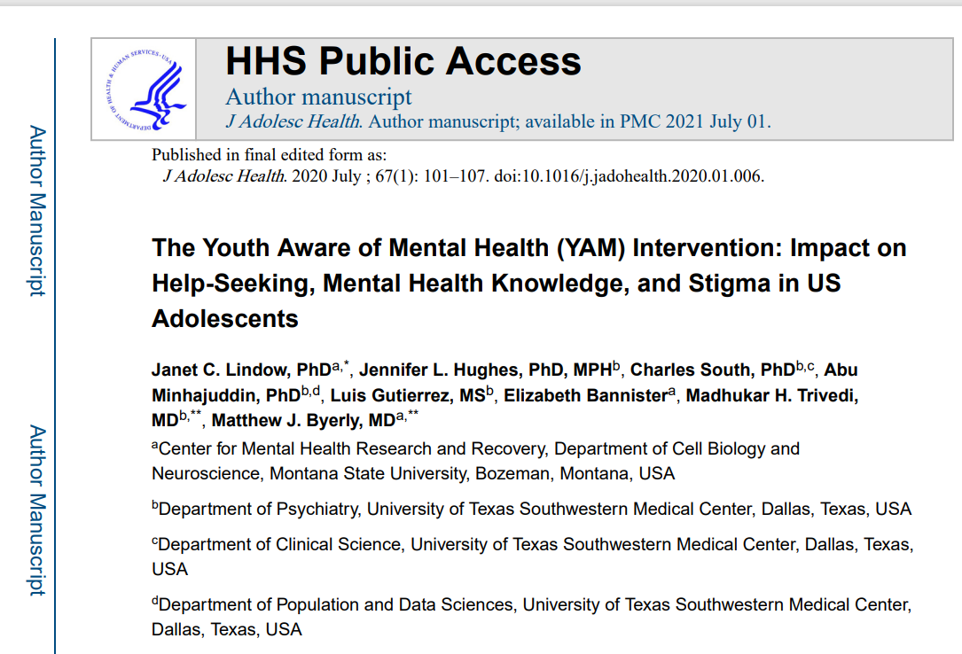
Replicated in Texas and Montana

Slide 10
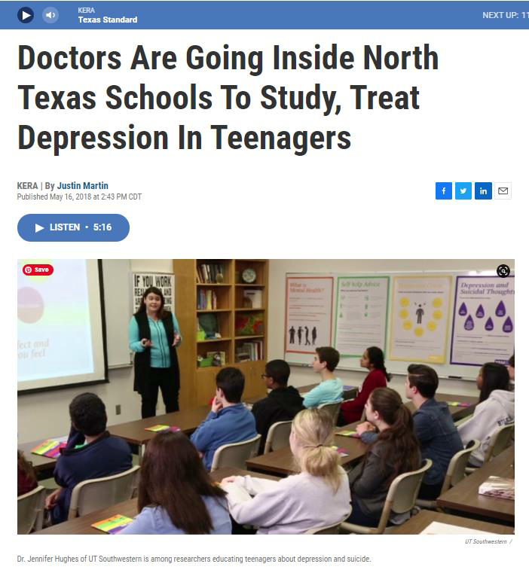
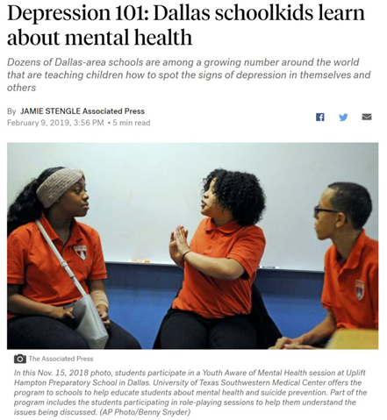
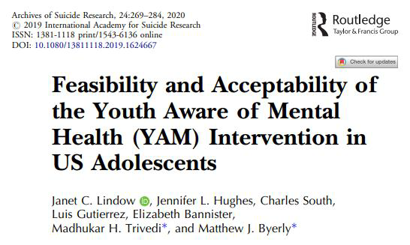
YAM in the United States

Slide 11

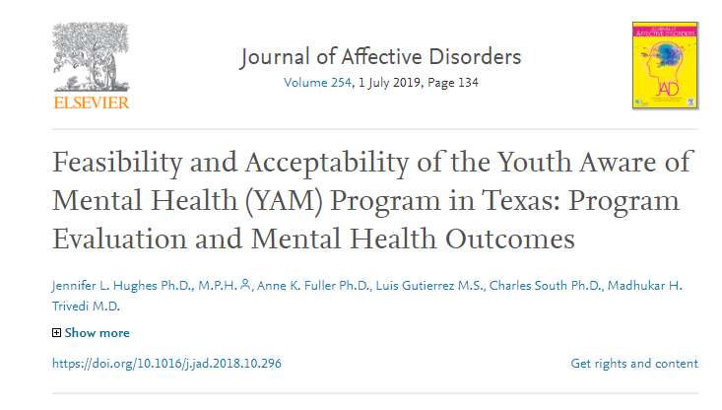
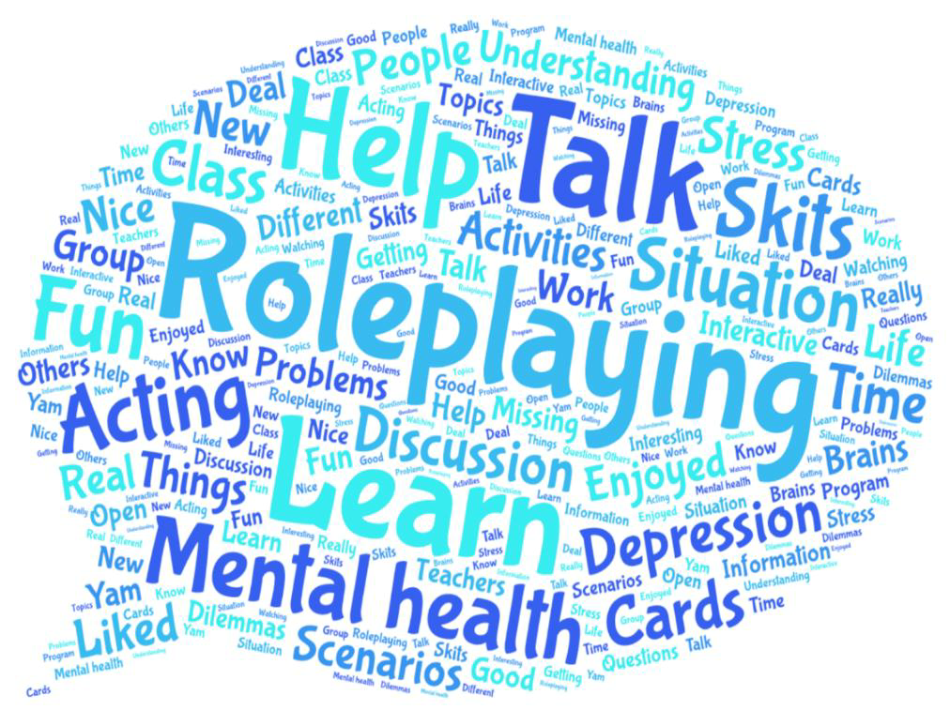
When asked, “What did you like best about YAM?”

Slide 12
YAM
Program
Description

Slide 13







Youth Aware of Mental Health (YAM)
A 5-hour evidence based, interactive mental health promotion program
Five 45-60 minute interactive sessions
Delivered over
3 or 5 weeks

Slide 14
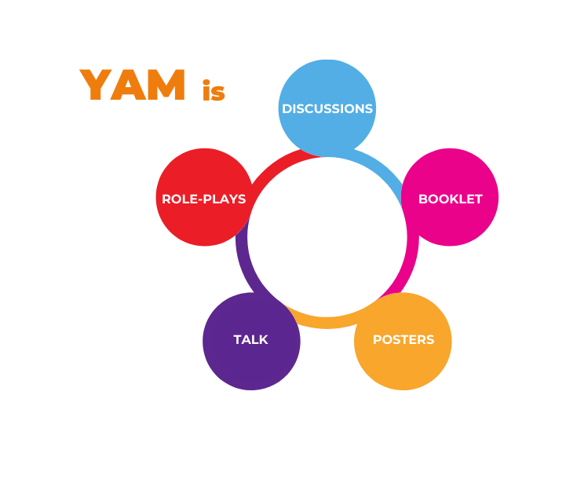
YAM focuses on six main themes:
What is Mental Health?
Self-Help Advice
Stress and Crisis
Depression and Suicidal Thoughts
Helping a Friend in Need
Who Can I Ask for Advice?

Slide 15
YAM Investment and Time
5 VISITS OVER 3 WEEKS
(for traditional schedules)
5 VISITS OVER 5 WEEKS (for traditional schedules)
3 VISITS OVER 3 WEEKS (for block schedules)
INVESTMENT The value of the program is incalculable when considering its correlation with healthy child development and depression prevention through fostering resilience.
TIME Depending on your school’s class schedule, YAM can be delivered as follows:
45-minute sessions
- 1st week: Two visits
- 2nd week: Two visits
- 3rd week: One visit
45-minute sessions
- 1 visit per week
- occurring on the same weekday
Two 90-minute + One 45-minute
session
- 1 visit per week
- occurring on the same weekday

Slide 16
YAM Delivery
Pre-evaluation completed day of first YAM session prior to presenting content
YAM Sessions
1-5 presented
Post-evaluation completed on last day after presentation of session 5 content

Slide 17
YAM Impact
Evidence suggests that YAM
should be done with
91 youth (or 3 classrooms)
in order to prevent
1 new suicide attempt or
1 new case of severe suicidal ideation

Slide 18
Conclusion
Evidence based intervention
Prevents depression and suicidal ideation
Promotes resilience
Cost effective
  Minimal or no risk

