Slide 1
YAM Project Updates
Madhukar Trivedi, MD
Center for Depression Research and Clinical Care
UT Southwestern Medical Center

Slide 2
YAM Train-the-Facilitator Sessions: HRI’s Represented
March 2022
TTUHSC
UTSA
UTSW
July 2022
TAMU
Dell
UT Tyler
UTSW
July 2022
TTUHSC
Dell
UT Houston
UTSA
UTSW

Slide 3
YAM Train-the-Facilitator Sessions: HRI’s Represented
August 2022
UTSA
UTMB
UTSW
UT Houston
Sept 2022
TAMU
TTUHSC
UT Houston
UTSA
UT Tyler
UTSW
Oct 2022
TAMU
Dell
TTUHSC
UT Houston
UTSA
UT Tyler
UTSW

Slide 4
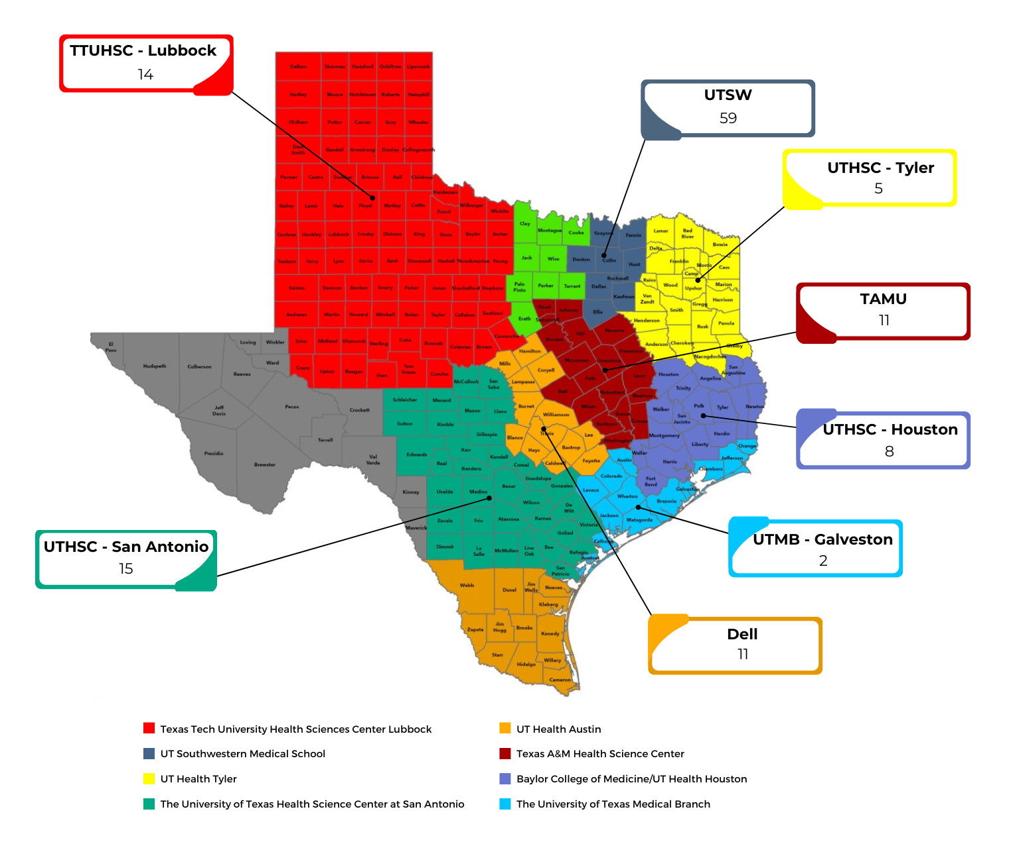
Progress: 125 Instructors Trained
Next Training Scheduled in December

Slide 5
Schools / Districts Engaged by HRIs
Dell
UTMB
Dickinson ISD
UTHSC Houston
Humble ISD
Pro-Vision Academy*
TAMU
TTUHSC
UTHSC San Antonio
UTHC Tyler
UTSW
Copperas Cove ISD
Dripping Springs ISD
Hays CISD
Wayside Schools
Fruitvale ISD*
Hawkins ISD
Winnsboro ISD
Friendswood ISD
Hitchcock ISD
Arlington ISD*
Beeville ISD
Bonham ISD
Ector ISD
Trenton ISD
Uplift Charter Network*
Eula ISD*
Houston ISD
Bronte ISD*
Irion County ISD
Santa Anna ISD*
Gunter ISD*
Plano ISD*
Harlandale ISD
San Antonio ISD
Boerne ISD
East Central ISD
Huntsville ISD
Killeen ISD
HEB ISD*
Arp ISD*
Vega ISD*
Santa Anna ISD*
Milano ISD
Buna ISD
College Station ISD
Bryan ISD
Elysian Fields ISD
Harper ISD
George West ISD
Poteet ISD
Aldine ISD
Pasadena ISD
Pearland ISD
Harmony Public Schools
Fort Bend ISD
Katy ISD
* = YAM already delivered / currently being delivered

Slide 6
YAM Student Reach
Spring 2022
1,800
Sept 2022
300
Oct 2022
900
Currently delivering YAM to ~1500 students
Projected Total Reach
at end of Nov 2022
5,000

Slide 7
YAM Student Classes
Spring 2022
98
Sept. 2022
22
Oct. 2022
38
Currently delivering YAM in ~75 classes
Projected Total Classes
at end of Nov 2022
~300

Slide 8
Sneak Peak – Depression Data Measures
Prior to YAM implementation - 25.8% of students scored ≥ 3 on PHQ-2

Slide 9
Sneak Peak – Anxiety Data Measures
Prior to YAM implementation – 26.4% of students scored ≥ 3 on GAD-2

Slide 10


