Slide 1
Bullying Prevention Through Supporting Responsible Social Media Use and Youth Mental Health
A New Approach and New Resources
Jeffrey Hutchinson, MD
10/10/2024

Slide 2
AAP Center of Excellence on Social Media and Youth Mental Health
Background
Fall 2022, AAP was awarded $10 million over five years from the U.S. Department of Health and Human Services (HHS), through the Substance Abuse and Mental Health Services Administration (SAMHSA), to establish a National Center of Excellence on Social Media and Mental Wellness.
The goals of the Center are to:
Improve pediatric mental wellbeing by reducing the risks and leveraging the benefits of social media
Build the capacity of individuals who work with youth to mitigate social media’s impact on mental wellbeing and promote healthy social media use
Synthesize and promote the evidence base and best practices for healthy social media use via communication, guidance, and other resources

Slide 3
Jenny Radesky, MD, FAAP
Megan Moreno, MD, MSEd, MPH, FAAP
Assistant Professor of Pediatrics & Developmental and Behavioral Pediatrician, University of Michigan Medical School
Professor and Interim Chair, Department of Pediatrics University of Wisconsin
Notes:
The work of the Center is informed and guided by our Co Medical Directors, Dr. Megan Moreno and Dr. Jenny Radesky. Dr. Moreno and Dr. Radesky are both researchers with expertise in digital media use and its impact on youth mental health and development.
Dr. Megan Moreno, Professor and Interim Chair, Department of Pediatrics, University of Wisconsin (Adolescent health)
Dr. Jenny Radesky, Assistant Professor of Pediatrics and Developmental and Behavioral Pediatrician, University of Michigan Medical School (early childhood)

Slide 4
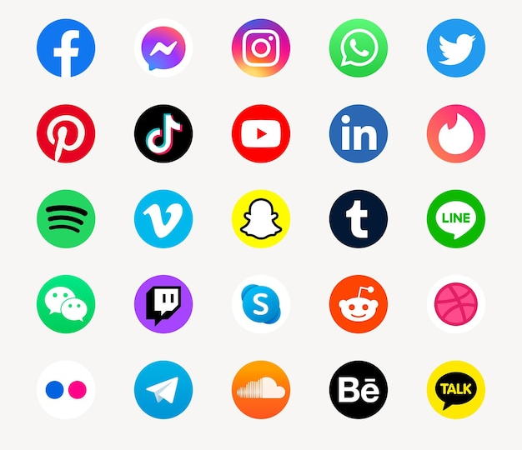
What is Social Media?
WE DEFINE 'SOCIAL MEDIA' VERY BROADLY
'Social Media' encompasses many platforms with varying design affordances
Prominent designs include hosting user-generated content, algorithmic recommendations, messaging, video-sharing, and business models that include marketing and monetization
Young children start using video-sharing platforms and online multiplayer videogames (e.g., YouTube, Roblox) that we include in our guidance
History of Social Media (It's Younger Than You Think) – BroadbandSearch
Free Vector | Social media icons vector set with facebook, instagram, twitter, tiktok, youtube logos (freepik.com)
Notes:
Free Vector | Social media icons vector set with facebook, instagram, twitter, tiktok, youtube logos (freepik.com)
Social media isn’t just Facebook or Twitter, there are so many social spaces where kids are on from early childhood. Examples are games like ROBLOX or Fortnight- where there is a multi-video gamer experience, Or in earlier childhood- like when a toddler watches YouTube videos
Social media is any Content that is created by users and posted on giant platforms and gives recommendations via automated processes; Social media can be monetized through advertisements, and it uses algorithms to keep the user engaged
It’s important to know that there is a broad range of technologies kids interact with and new platforms are launching all the time
The Center is taking a broad lens and saying we are not just talking about Instagram- we are talking about teenagers who love Reddit- a kid who loves Snap and we are having open conversations about what that experience looks like.

Slide 5
Social Media Use in Children 8 & Under
Understanding Motivations and Functions
Entertainment (ie, videos, games, music)
Social relationships/connecting with family or peers
Distraction and emotion regulation
Education
“Researching” toys or exploring content
Watching influencers or other children who are uploading content
Following celebrities
Posting their own videos (until their account is taken down)
Watching YouTube Videos (aap.org)
Preferred method of screen time/Selecting best shows/games for toddlers (aap.org)
Notes:
Focus on quality, routines, togetherness, and emotions?
What is high quality?

Slide 6
Adolescents Use Social Media in Diverse Ways
Understanding Motivations and Functions
Social: Communicating with friends, building larger networks based on interests (e.g., fandoms), maintaining relationships
Emotional: Seeking support, relieving stress
Functional: Planning events, engaging around assignments
Identity: Exploring sense of self, seeing reactions from others, feeling understood, finding communities and learning about others’ identities
All of this is “real life” to them
Notes:
When thinking about social media and youth mental health, it is often important to pause for a moment to ensure that we are thinking not only as researchers, clinicians, or parents, so adults ☺ but also from the perspective of youth. What are some of the ways that adolescents use social media and to meet what types of needs?

Slide 7
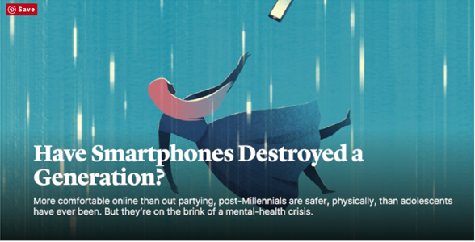
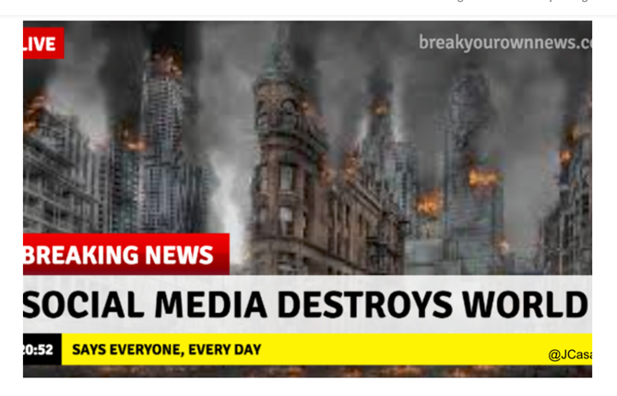
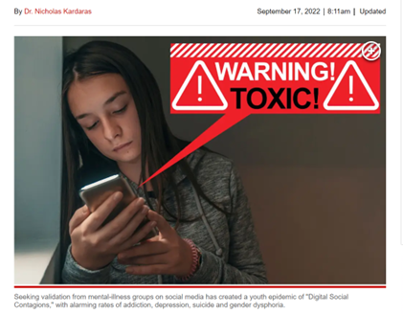
The Popular Narrative
The dominant narrative has focused on risk
Notes:
But those motivations and functions aren’t often what you hear about in the media or from other prominent voices. What we do hear is the popular narrative.

Slide 8
What is the impact of the popular narrative?
The current narrative is
Spread by news media
Captures attention
Leads to shame and guilt that is internalized by kids and families
→ Parents want to give up or tighten control
→ Teens blame themselves
Shame and guilt do not lead to healthy behaviors or self-efficacy

Slide 9
Current Research: What We Know
Notes:
What do we find when we dig deeper into this fear-based narrative? Well, if we look at what the science tells us about time spent on screens…

Slide 10
Links between ‘screen time’ and young children’s wellbeing
Small but significant associations between the amount of time young children spend on digital media and language delays, sleep problems, sedentary behavior, etc.
Viewing educational media is associated with better language development
Links between ‘screen time’ and adolescent wellbeing
Summary of Research: 1/3 of teens have potential mental health consequences, but often also have other factors that put them at increased risk:
BUT media use correlates with lower socioeconomic status, higher family stress, less access to developmental opportunities
Existing mental health issues
A less supportive home environment (less connection to parents, more parent social media use)
‘Screen time’ measures are imprecise; 1 hour spent on social media can mean very different things to different teens
Not every teen has the same risks/benefit calculation
Annual Research Review: Adolescent mental health in the digital age: facts, fears, and future directions - PubMed (nih.gov)
Longitudinal or Daily Linkages - PubMed (nih.gov)
Beyensetal.-2020-Theeffectofsocialmediaonwell-beingdiffersfromadolescenttoadolescent.pdf
Moreno MA, et al. JMIR Pediatrics and Parenting. 2022.
Coyne, S.M., et al., Family. 2022

Slide 11
Better Measures of Social Media Use
Focus on how adolescents use it
Passive vs active social media participation
Frequency of bullying/toxic content
Exposure to idealized body/beauty content and body dissatisfaction
Evening/long hours and poor sleep
Civic engagement and affirming communities for youth from marginalized groups (but it is still a lot of work to navigate)
Hale et al., Curr Sleep Med 2019
Kross et al., Trends Cog Sci 2021
Li, et al. Eur Child Adol Psych, 2022
Fioravanti et al., Adol Res Rev 2022
Moreno et al, Pediatrics 2016
Notes:
Better measures of social media use in the literature focus on HOW adolescents are using social media. For example,
“Passive” use was associated with negative outcomes
Active use and interaction with others was not associated with negative outcomes
So studies that demonstrate quality of use may be more important than quantity

Slide 12
Where does this leave us?
The popular narrative is focused on screen time and risk-based messages
Social media is not the only potentially risky activity we allow and encourage kids to do as part of their development
These risks are not universal to all kids, and are not driven by a single measure of “screen time”
If our goal is to center on youth and their health, we need to change our approaches
Notes:
Social media is not the only potentially risky activity we allow and encourage kids to do as part of their development
Driving a car
Playing a sport
Getting a job

Slide 13
A New Narrative
Making words matter
Emphasize children’s innate resilience and unique characteristics that are developmentally adaptive (eg, curiosity, attracted to novelty, seeking peer reactions) but don’t always interact well with the adult-built environments around them.
Recognize that we need to act now to help youth through the mental health crisis (and prevent mental health problems in younger children), but avoids reinforcing the dominant polarized discourse (eg, only blaming technology).
Create and amplify resources and interventions that are multi-level, involve all stakeholders and relationships children have, addresses the psychological and sociological factors that shape media use and how children react to it.
Notes:
We have every reason to be concerned about the mental health crisis for adolescents
The way we are talking about it is not going to contribute to solutions
Good decisions that work for diverse families and stakeholders are not made from a place of shame or fear

Slide 14
Center of Excellence Framework
Concepts to Remember
Centering on the child/adolescent: Help youth and caregivers provide support for autonomy, agency, advancing skills in digital citizenship and literacy, support self-regulation, and parental role modeling and open-minded conversation
Developmental lens: Provide resources to support healthy relationships with technology from infancy, focusing on important emotional and relational processes that can be hindered or supported with technology
Importance of context: Support balanced parent technology use; affirm what the family is already doing to help the child’s mental health, academic wellbeing, and connection to community; understand sociocultural drivers of media use
Individual differences: Tailor approaches to the strengths and challenges of each child/family
Digital ecosystem design: Advocate for policy change. Metrics of platform success (eg, engagement) may be at odds with metrics of child wellbeing (sleep, homework completion/focus)
Notes:
1 Exert agency within the digital ecosystem, including deciding when to engage/disengage, resisting nudges, deciding what is worth their time and attention
2 Emotional awareness and self-regulation
Social reciprocity/perspective taking
Identity formation and exploration
3 Social media use does not occur within a vacuum, and solutions that only involve ceasing child technology use will not help solve interrelated issues. Youth use media to relieve stress, engage with (or escape) from civic challenges, seek support they cannot find locally. Important to consider the child’s other opportunities Parent technology use influences both youth media use and emotional wellbeing
4 Child and adolescents vary in their innate and learned emotion regulation, distress tolerance, social skills/perspective taking, sensory-seeking, and play preferences.
Children from different races/ethnicities, gender identities, sexualities have very different experiences online
This influences how much they are drawn to certain types of media, and how they respond to media/what it displaces
characteristics shape how they use media, what they seek from it, and how it affects them.
5 Much of the digital environment was designed around adult ‘average users’ and goals of increasing social networks, engagement, and sharing information
User-generated content can be inspirational and affirming or manipulative and toxic; automated systems can’t identify and filter it all.

Slide 15
Strategies to Mitigate the Risk of Cyberbullying

Slide 16
What is Cyberbullying
Most definitions describe cyberbullying as a repeated activity conducted using digital technologies with the intent to cause harm and can include:
Harassment (insults or threats)
Spreading lies/rumors
Posting embarrassing photos or videos
Impersonations
Outing
Trickery (gaining an individual’s trust and then using online media to distribute their secrets)
Exclusion (excluding an individual from activities)
It is often a repeated behavior, aimed at scaring, angering, or shaming those who are targeted
Face-to-face bullying and cyberbullying can often happen alongside each other
Cyberbullying leaves a digital footprint – a record that provides evidence to help stop the abuse
Cyberbullying: What is it and how to stop it | UNICEF
Cyberbullying: Hiding behind the screen - PMC (nih.gov)
What Is Cyberbullying | StopBullying.gov
What Is Cyberbullying? | Common Sense Media
‌

Slide 17
Cyberbullying- What We Know
The Youth Risk Behavior Surveillance System indicates that:
In 2023, 16% of high school students were electronically bullied, including through texting, Instagram, Facebook, or other social media, during the past year
Sociodemographic characteristics were strong predictors of being bullied in school and electronically
According to Common Sense Media:
High school and middle school teachers also report that cyberbullying happens frequently in 1 in 5 classrooms
Problematic internet use among older adolescents: A conceptual framework – ScienceDirect
YRBS Data Summary & Trends Report | Youth Risk Behavior Surveillance System (YRBSS) | CDC (page 48)
What Is Bullying | StopBullying.gov
Children | Free Full-Text | Factors Predicting In-School and Electronic Bullying among High School Students in the United States: An Analysis of the 2021 Youth Risk Behavior Surveillance System
2023 Cyberbullying Data - Cyberbullying Research Center
How Common Is Cyberbullying? | Common Sense Media

Slide 18
Cyberbullying Prevention
Recognize possible signs of cyberbullying:
Unexpectedly stops using their devices or unusually secretive
Appears nervous or jumpy when using their device(s)
Appears uneasy about going to school or to other events where their peers are
Appears to be angry, depressed, or frustrated after texting, using social media, or gaming
Sudden changes in sleep and/or eating behaviors
Sudden or abnormal withdrawal from family or friends
Seems regularly depressed
Loses interest in the things that mattered most to them or talks about hurting themselves or suicide
Avoids discussions about what they are doing online
Frequently calls/texts from school requesting to go home ill
Desires to spend much more time with parents rather than peers
Cyberbullying Research Center - How to Identify, Prevent, and Respond
cyberbullying-warning-signs.pdf
Recommendations for cyberbullying prevention and intervention: A Western Canadian perspective from key stakeholders - PMC (nih.gov)
Warning Signs for Bullying | StopBullying.gov

Slide 19
Tips for Educators
Response
Prevention
Respond when it happens
Investigate
Support youth who was bullied
Enlist the support of a school liaison officer or law enforcement help
Develop a response
Work with parents
Keep evidence of cyberbullying
Remember the goal is to stop the bullying
Learn about cyberbullying including what it is, warning signs, and who is most at risk
Establish a safe school climate
Talk about bullying & cyberbullying
Learn about state & federal laws
Establish rules & policies
Develop a plan to respond
What You Can Do | StopBullying.gov
Notes:
1. THOROUGHLY INVESTIGATE all incidents so that you can direct resources and, if necessary, discipline to students who require it.
2. ENLIST THE SUPPORT OF A SCHOOL LIAISON OFFICER or another member of law enforcement to help, especially when behaviors include a possible threat to the safety of students or staff.
3. Once you identify the offending party, DEVELOP A RESPONSE THAT IS COMMENSURATE WITH THE HARM DONE and the disruption that occurred.
4. WORK WITH PARENTS to convey to the student that cyberbullying behaviors are taken seriously and will not be tolerated whether they occur at school or not. Anything that disrupts the learning environment at school is subject to discipline.
7. KEEP ALL EVIDENCE OF CYBERBULLYING. Keep a file with screen shots, message logs, or any other evidence so that you can demonstrate the seriousness of the behavior and its impact on the school. This is especially critical if you intend to formally punish students (e.g., suspension or expulsion).
8. CONTACT AND WORK WITH the website, game, or app on which the abuse occurred. By now they are used to working through cyberbullying cases and can be a resource to assist you in removing offending content, gathering evidence, or to put you in touch with someone who can help.
9. USE CREATIVE INFORMAL RESPONSE STRATEGIES, particularly for relatively minor forms of cyberbullying that do not result in significant harm. For example, students may be required to create anti-cyberbullying posters to be displayed throughout the school. Older students might be required to give a brief presentation to younger students about the importance of responsibly using technology. It is important to condemn the behavior while sending a message to the rest of the school community that bullying in any form is wrong.
10. REMEMBER THAT THE GOAL IS TO STOP THE BULLYING. This objective should guide your intervention efforts. Do whatever is necessary to stop the bullying. It might be a simple talk with the aggressor or require a more significant response. Follow-up to make sure the bullying has stopped. If not, pursue additional remedies until it does.

Slide 20
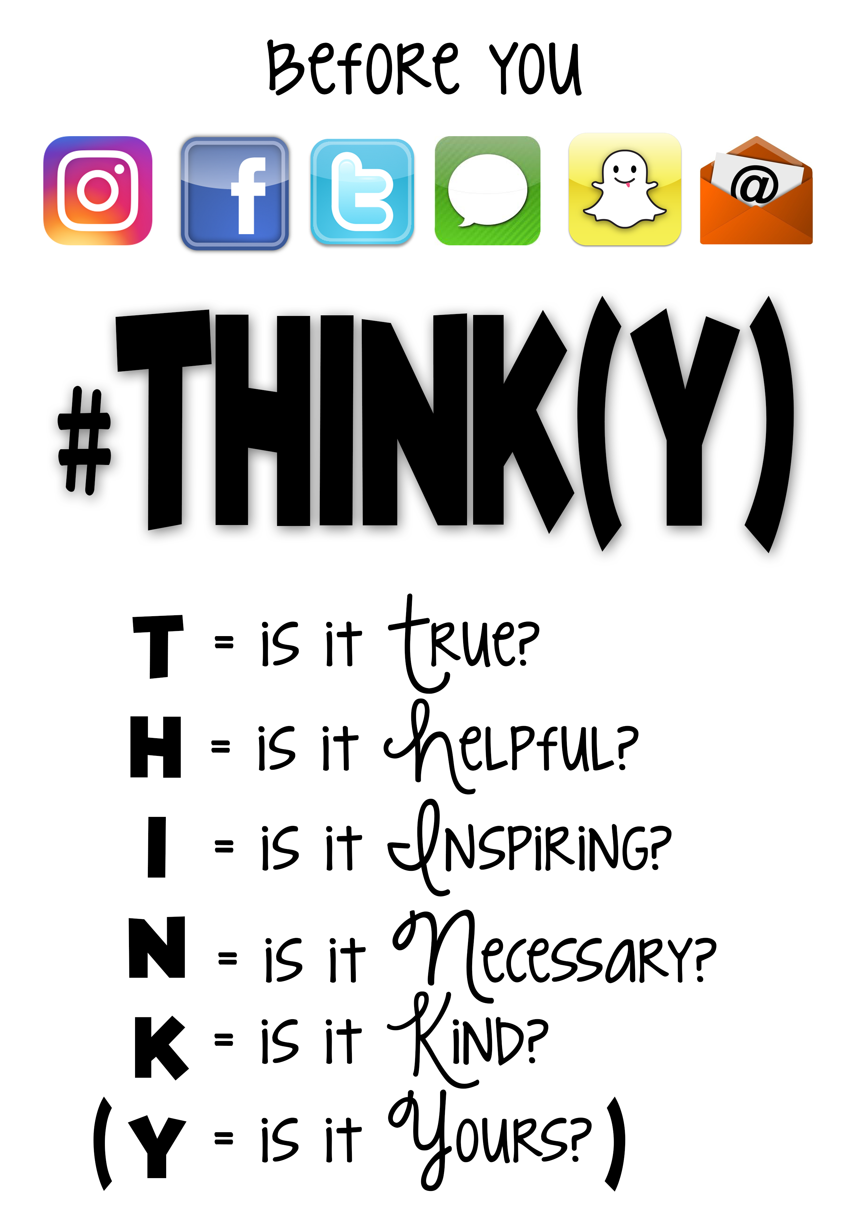
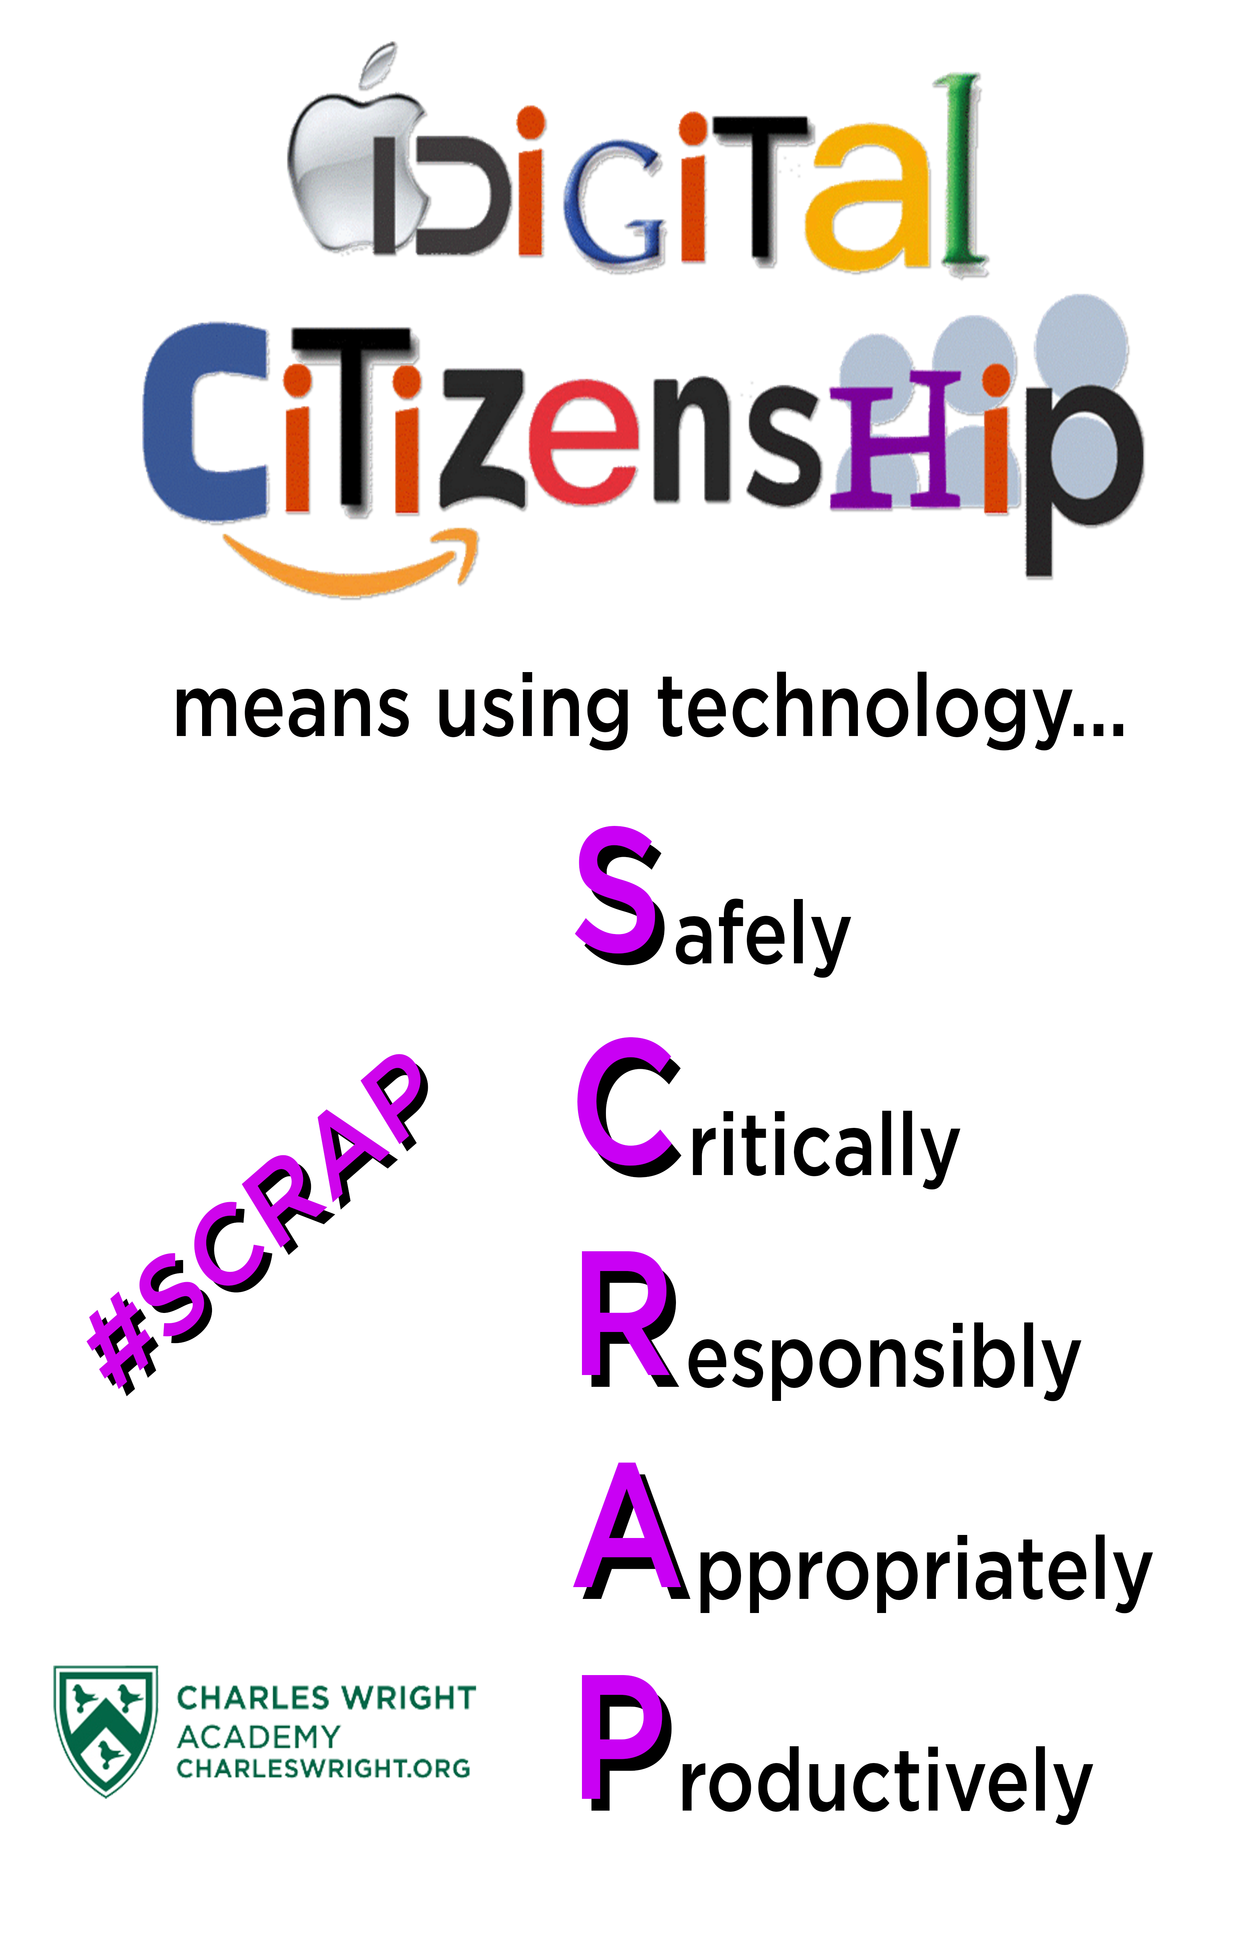
Prevention at School: What Can Kids Do?
Share with care
Think before you share
Who could this reach?
Will it affect others?
Can’t take it back
It’s cool to be kind
Respect others
Tone matters
Don’t put everything in a chat
Don’t impersonate
Stand up to cyberbullying
What is cyberbullying?
What are the consequences of bullying?
What to do when a peer has been bullied?
What to do when you are bullied?
The protection connection
Use privacy settings
Don’t give personal info
Protect your accounts & devices
Heads Up: Stop. Think. Connect. | Consumer Advice (ftc.gov)
Prevention at School | StopBullying.gov
What Kids Can Do | StopBullying.gov
Notes:
Share with Care
Think before you share
What you do online has real-world consequences. The photos, videos, and messages you share affect you, your privacy, your reputation, and those of the people around you — now and in the future. Stop and think before you post.
What you post could have a bigger “audience” than you think. It’s impossible to completely control who sees your profile, pictures, videos, or texts — even if you use privacy settings or apps that delete your content after it’s viewed or within 24 hours. Anybody who sees your post can take a screenshot or recording. Ask yourself: “Would I want someone to stand up in the middle of lunchtime and share that photo or video with the entire cafeteria?”
What you share might affect others. It can be embarrassing, unfair, and even unsafe to send or post photos and videos without getting permission from the people in them. Get someone’s OK first. Before you post, ask them: “Are you okay if I post this on social?” If they say no, don’t post it.
Once you post something online, you can’t take it back
Even if you delete something you’ve posted — or the post expires — that photo or comment you don’t want people to see anymore could be saved, shared, and live somewhere online — permanently.
Sexting: Don’t do it
You may have heard stories at school or in the news about people “sexting” — sending nude photos from their phones. Don’t do it. Period. Creating, forwarding, or even saving sexually explicit photos, videos, or messages puts your friendships and reputation at risk. Worse yet, you could be breaking the law.
A note about social media
According to the U.S. Surgeon General, using social media can hurt you, depending on how much time you spend on the platforms, the type of content you see, and how much it disrupts things like your sleep or exercise — those activities that are essential for your health.
Both images are mine, created for use at school, hanging in classrooms
THINK(Y) is a modified version of a poster inspired by Technology Rocks Seriously (no longer online) – it comes from the popular saying, “Think before you speak” – changed for the digital age
Image 2: Social Media Logo Vectors & Illustrations for Free Download (freepik.com) (both images made in Canva)

Slide 21
If you or someone you know is struggling with a mental health crisis, contact the 988 Suicide and Crisis Lifeline by dialing 9-8-8 or texting TALK to 741-741.

Slide 22
Activities and Resources

Slide 23
AAP Center of Excellence on Social Media and Youth Mental Health Website
aap.org/socialmedia
Upcoming Programs
Q&A Portal
Tools and Resources
Multimedia Resources
Contact Information
Newsletter Sign-Up
Additional Information

Slide 24
Question & Answer Portal
Interactive Q&A Portal: a two-way communication channel that allows clinicians, educators, parents/families, youth, and others to submit questions about social media and mental well-being
Our Center team, including our Co-Medical Directors, review all questions and develop prompt evidence-based responses that will be emailed to users
Searchable by audience and age and includes all previously asked questions and responses made to date
Questions so far range in topic from school policies on digital devices to how to support young children’s behavior related to digital media to how to support teens expressing body image concerns

Slide 25
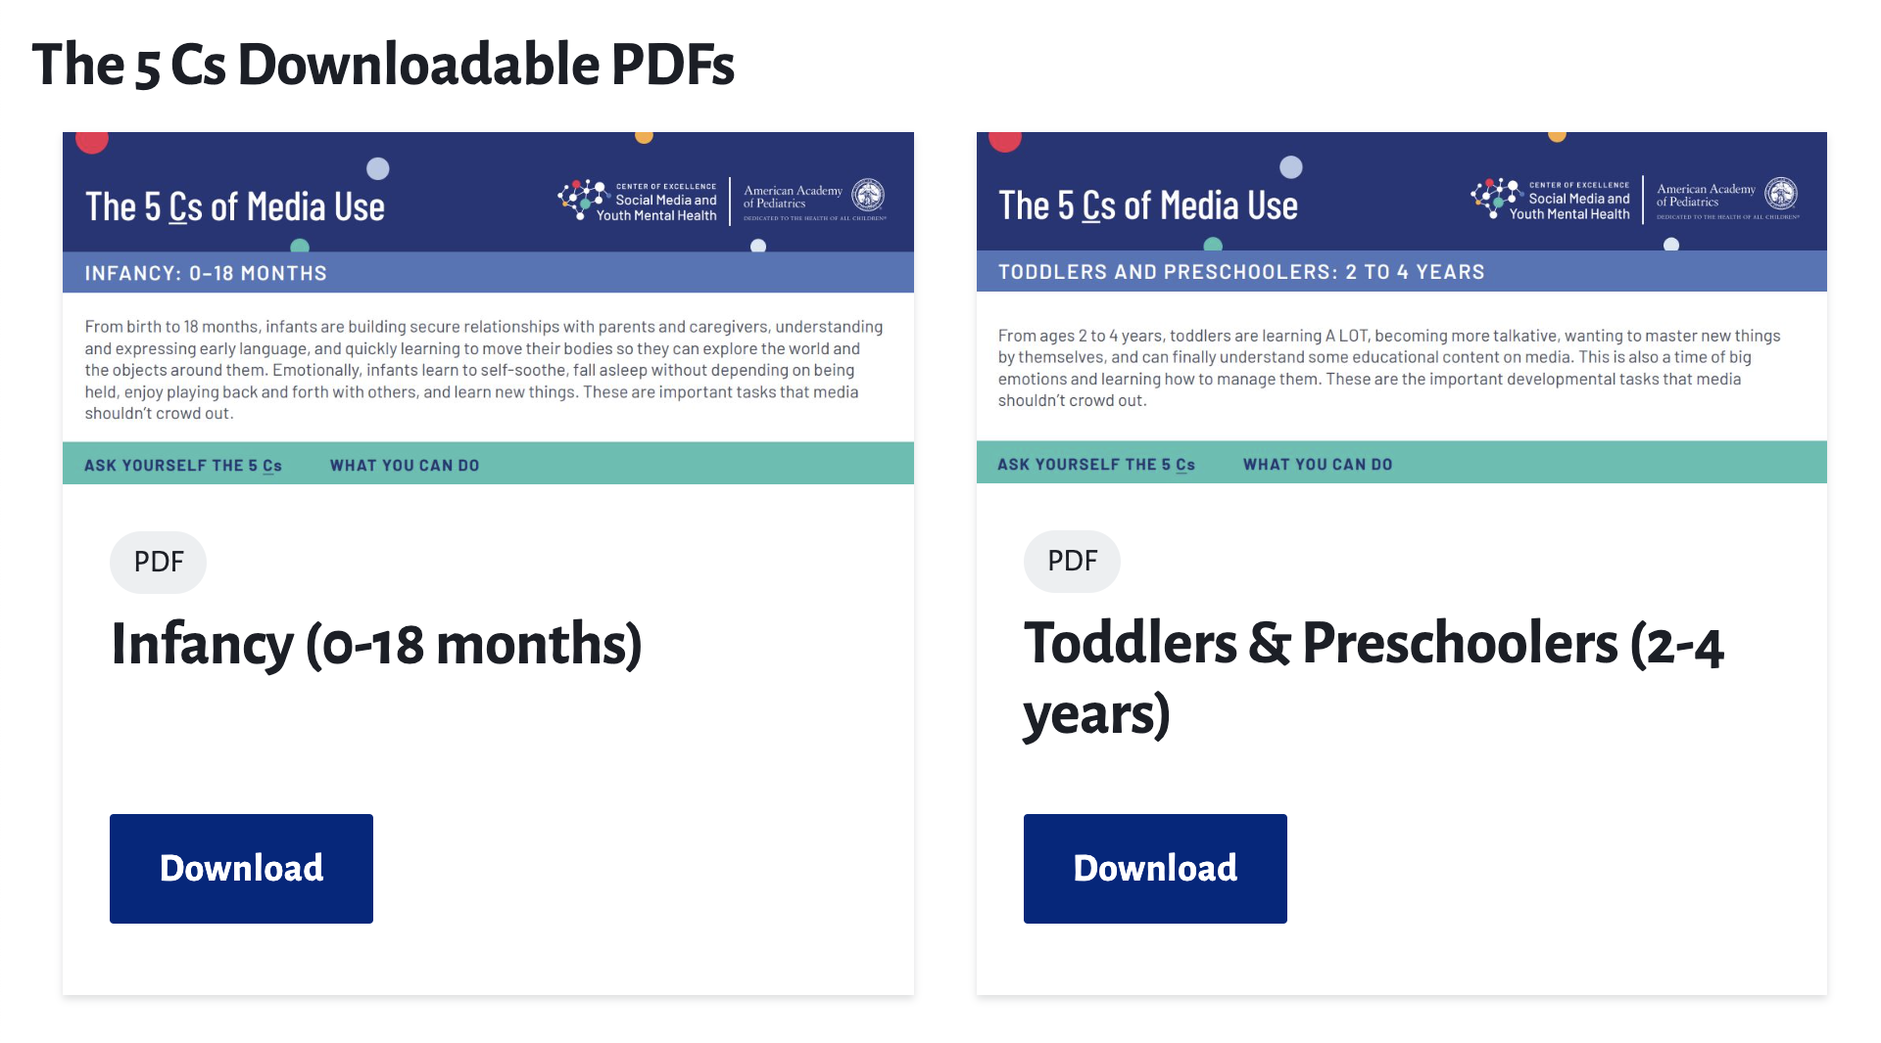
The 5 Cs of Media Use
Handouts on specific developmental stages, how these stages influence media use, and the healthiest media habits to strive for at that stage.
Child
Content
Calm
Crowding Out
Communication
The five age-based handouts can be downloaded at
aap.org/5Cs
Notes:
Pediatricians and providers often need quick, simple ways to discuss digital media with families. To help, we developed The 5 Cs of Media Use.
The 5 Cs is a mnemonic that can be used to talk to parents about kids and screens. They are: Child, Content, Calm, Crowding Out, and Communication. Along with this approach, we’ve created a series of five age-based handouts to give to parents at well-child visits.
Based on current research and evidence, the handouts start by informing parents about their children’s developmental stages, how this influences media use, and healthy media habits to strive for at home.
The 5 Cs are designed to meet kids, teens and parents where they are, build insight and communication skills, and motivate for healthy behavior change.

Slide 26
The 5 Cs - Strengths-Based Framework
PROVIDING SIMPLE BUT NUANCED GUIDANCE
Child: Who is your child/adolescent, their unique strengths and challenges? How does this shape their media use and how they react to it?
Content: What content is high-quality and worth our time? How does negative content affect our thoughts and emotions?
Calm: How does your child calm down strong emotions and settle down for sleep?
Crowding Out: When we use media for too long, what does it get in the way of?
Communication: Regularly talking about your family’s digital experiences, supporting critical thinking and problem-solving.

Slide 27
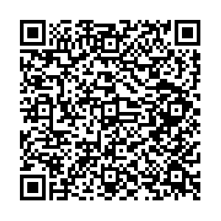
RESOURCES: Conversation Starters for Teens
Questions and prompts developed for parents to use with their teens to gather input, make decisions together, and have conversations about technology
Includes ideas about when and when not to have these types of conversations
Conversation starter topics include:
Setting initial boundaries around technology and digital media
Checking in on unwanted content
Media and technology interfering with sleep
Prompts to encourage reflection around relationships with media
And others!

Slide 28
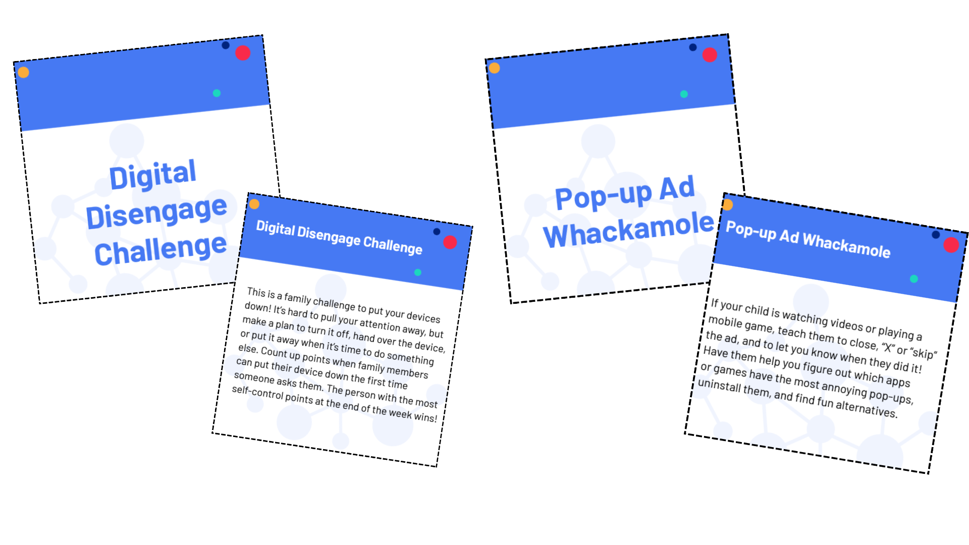
Building Healthy Relationships with Media: Essential Skills for Children 10 and Younger
Suggested activities and printable activity cards offer fun ways for families to develop healthy media habits from a young age
They focus on ways to build balance, critical thinking, self-regulation, and safety skills
Activities like Pop-up Ad Whackamole and Scam Finder engage young minds and create digital literacy skills
Can be used in tandem with the conversation starters for families with children of all ages

Slide 29
Digital Resources
AAP Family Media Plan
Family Tip Sheet- Building Healthy Digital Habits
Videos for Youth
When it comes to helping your children build healthy digital habits, you may not know where to start. Here are some research-based tips from pediatricians that can make a big difference for your family.
This tool helps family and youth set media priorities and create a plan that is adaptable over time.
4 Quick Social Media Tips for Teens

Slide 30
Questions?

Slide 31
Thank you!
Contact Us: socialmedia@aap.org

