Slide 1
Emergence Health Network Texas System of Care
Thursday, April 11th, 2024

Slide 2
Emergence Health Network (EHN)
EHN is the local mental health authority for the El Paso area and surrounding communities
Child & Adolescent Department (CAD) Clinic Programs include:
Outpatient services
Multi-systemic Therapy (MST)
Coordinated Specialty Care (CSC)
School-Based Mental Health (SBMH)
Wraparound Services
PHP/IOP-Partial Hospitalization Program/Intensive Outpatient Program
TRY- Treatment Recovery Youth – Substance use for youth
Commercial services for medication management

Slide 3
Emergence Health Network (EHN)
Fully licensed therapists (LCSW & LPC)
Provisionally licensed therapists (LMSW & LPC-A)
School-based Interventionist (QMHP)
Peer Support
Family Partner
Psychiatry
Licensed Chemical Dependency Counselor (LCDC)

Slide 4
Texas System of Care Framework (TxSOC)
The TxSOC is a framework designed to strengthen connections between local agencies, restore community hope, and improve the landscape of mental health care for youth and their families.

Slide 5
TxSOC Governance Board
Governance Board meets every other month to identify gaps in mental health services.
Youth Voice and Family Voice subcommittees were combined as both committee goals align and have hopes it will boost member recruitment and engagement.

Slide 6
TxSOC Partnership with Canutillo ISD

Slide 7
txsoc & Canutillo isd
TxSOC is currently embedded in the Canutillo Independent School District (CISD) where students have access to an array of mental health services.
CISD has 10 campuses and 2 programs
TxSOC Staff collaborate with CISD school counselors and administrators monthly to address any concerns that may occur.

Slide 8
Canutillo ISD Demographics Jocelyn Cepeda, CISD Social Worker Dayanira Carrillo, CISD Social Worker
TxSOC staff are housed at 3 different campuses within CISD;
Canutillo Middle School
Canutillo High School
Northwest Early College High School
Number of students per campus
Canutillo MS: 627
Canutillo HS: 1524
Northwest Early College HS: 355

Slide 9
Canutillo ISD Cont.
CISD offers many resources through Community Connections to include;
Community Closet
Lone Star Cupboard
Lone Star Library
Superior Care Closet
Victory Greenhouse
Steppers Closet
School Bin

Slide 10
TxSOC impact on Canutillo ISD
How impactful has TxSOC been within the 3 campuses?
What feedback has students or parents provided regarding the increased access to mental health services on campus?

Slide 11
TxSOC Mulit-tier Support System (MTSS)
MTSS is a framework that focuses on serving all students through a comprehensive continuum of care and involves strategies to proactively identify students who are at-risk of developing mental or behavioral health challenges, which includes:
Universal screening and referral systems
Match student needs to evidence-based interventions
Student progress is monitored through the collection of data, which is used to make decisions about care
TxSOC uses elements of the MTSS framework to make informed decisions about our school-based mental health services.

Slide 12
Meet Texas System of Care Staff

Slide 13
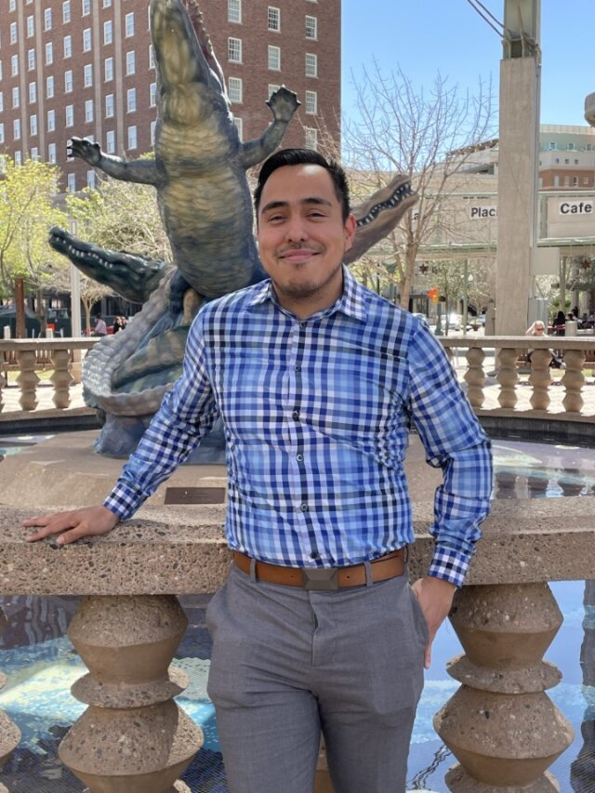
Matthew Rodriguez
Evaluations Assistant
Marcos Cardona
Associate Therapist
Guadalupe Garate
School Based Interventionist

Slide 14
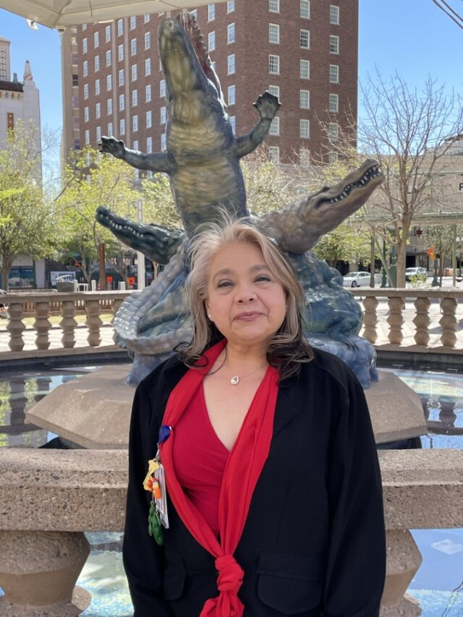
Selicia Ramirez
Youth Peer Support
Cecilia Morales
Family Partner

Slide 15
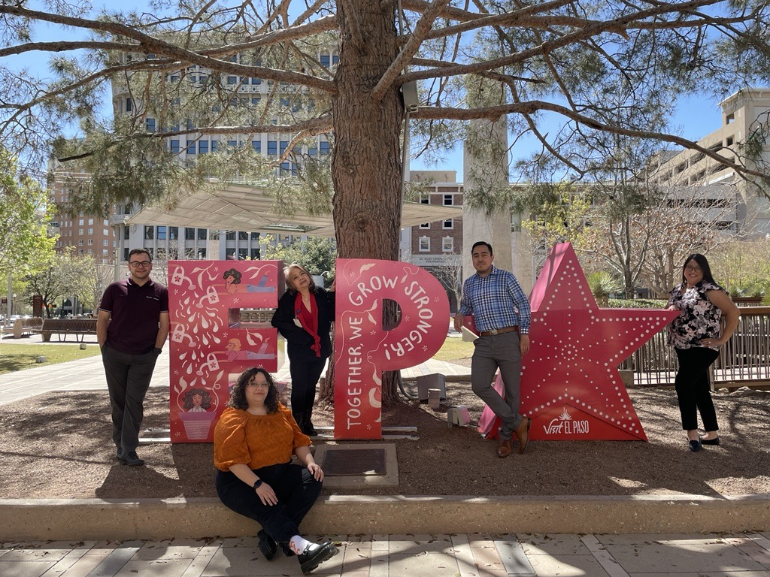

Slide 16
TxSOC Barriers and Solutions

Slide 17
BARRIERS
Limited space at the campuses to conduct sessions
Pulling students out for sessions in a confidential and timely manner
Difficulty providing services during testing periods
Parental involvement for ongoing services and sessions

Slide 18
SOLUTIONS
Monthly meetings with school counselors and administrators
Open communication with school leadership
Develop policies and procedures collaboratively with school district
Offer and educate on community-based services
Parent education and support for ongoing involvement in services

Slide 19
Engaging Caregivers and Families

Slide 20
STRATEGIES
Flexible service delivery options
Individualized treatment plan and services utilizing evidenced based practices
Use of fidget toys and games for rapport building
Referring and linking families to resources and supports in the community as needed
Notes:
Bullet 1-
Service delivery options are in person, community-based and telehealth
Bullet 2-
Each student has a treatment plan completed that is individualized to their mental health needs
We use EBP such as nurturing parenting, Skillstreaming to help with tailored interventions for each student and family
Bullet 3-
Use fun ways to connect with students and make MH services less intimidating

Slide 21
Parent Cafes
The El Paso Center for Children in collaboration with Be Strong Families, trained TxSOC staff to become a Parent Café host.
Cafés focus on building and promoting five protective factors to reduce risk and create optimal outcomes for children, youth, and families. These include:
Parental Resilience
Social Connections
Knowledge of Parental and Child Development
Concrete Support in Times of Need
Social and Emotional Competence of Children
Notes:
Talking about why Parent Cafés are important. Another way to get engagement is hosting parent cafes. Teaching families to work with their informal supports

Slide 22
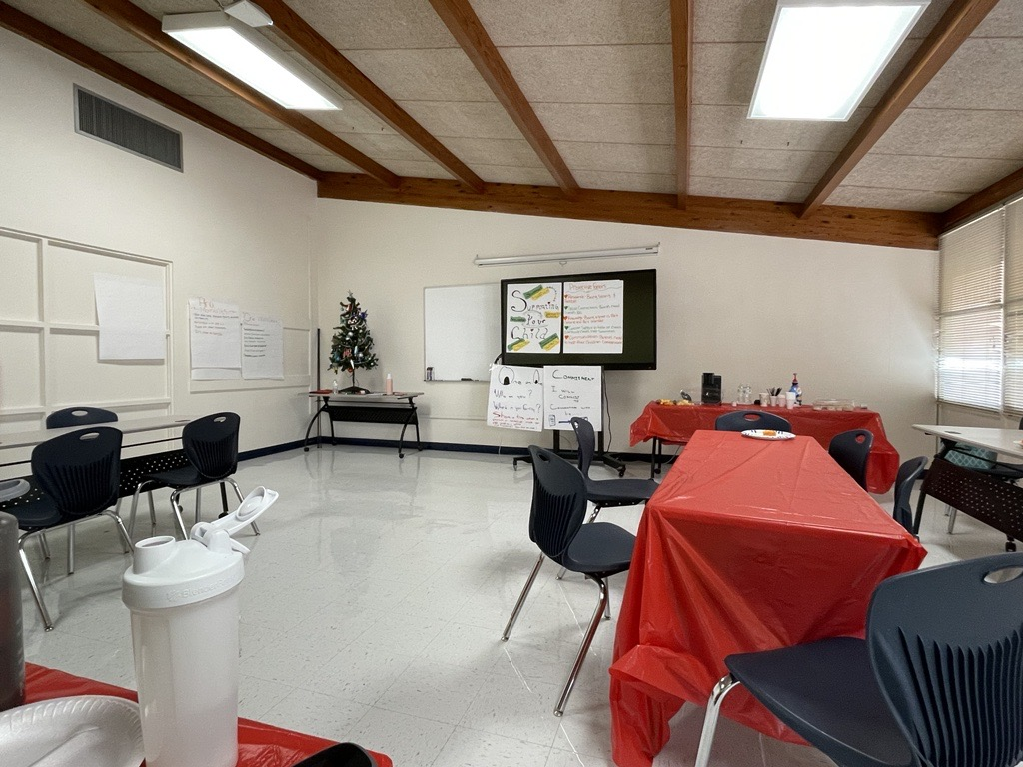
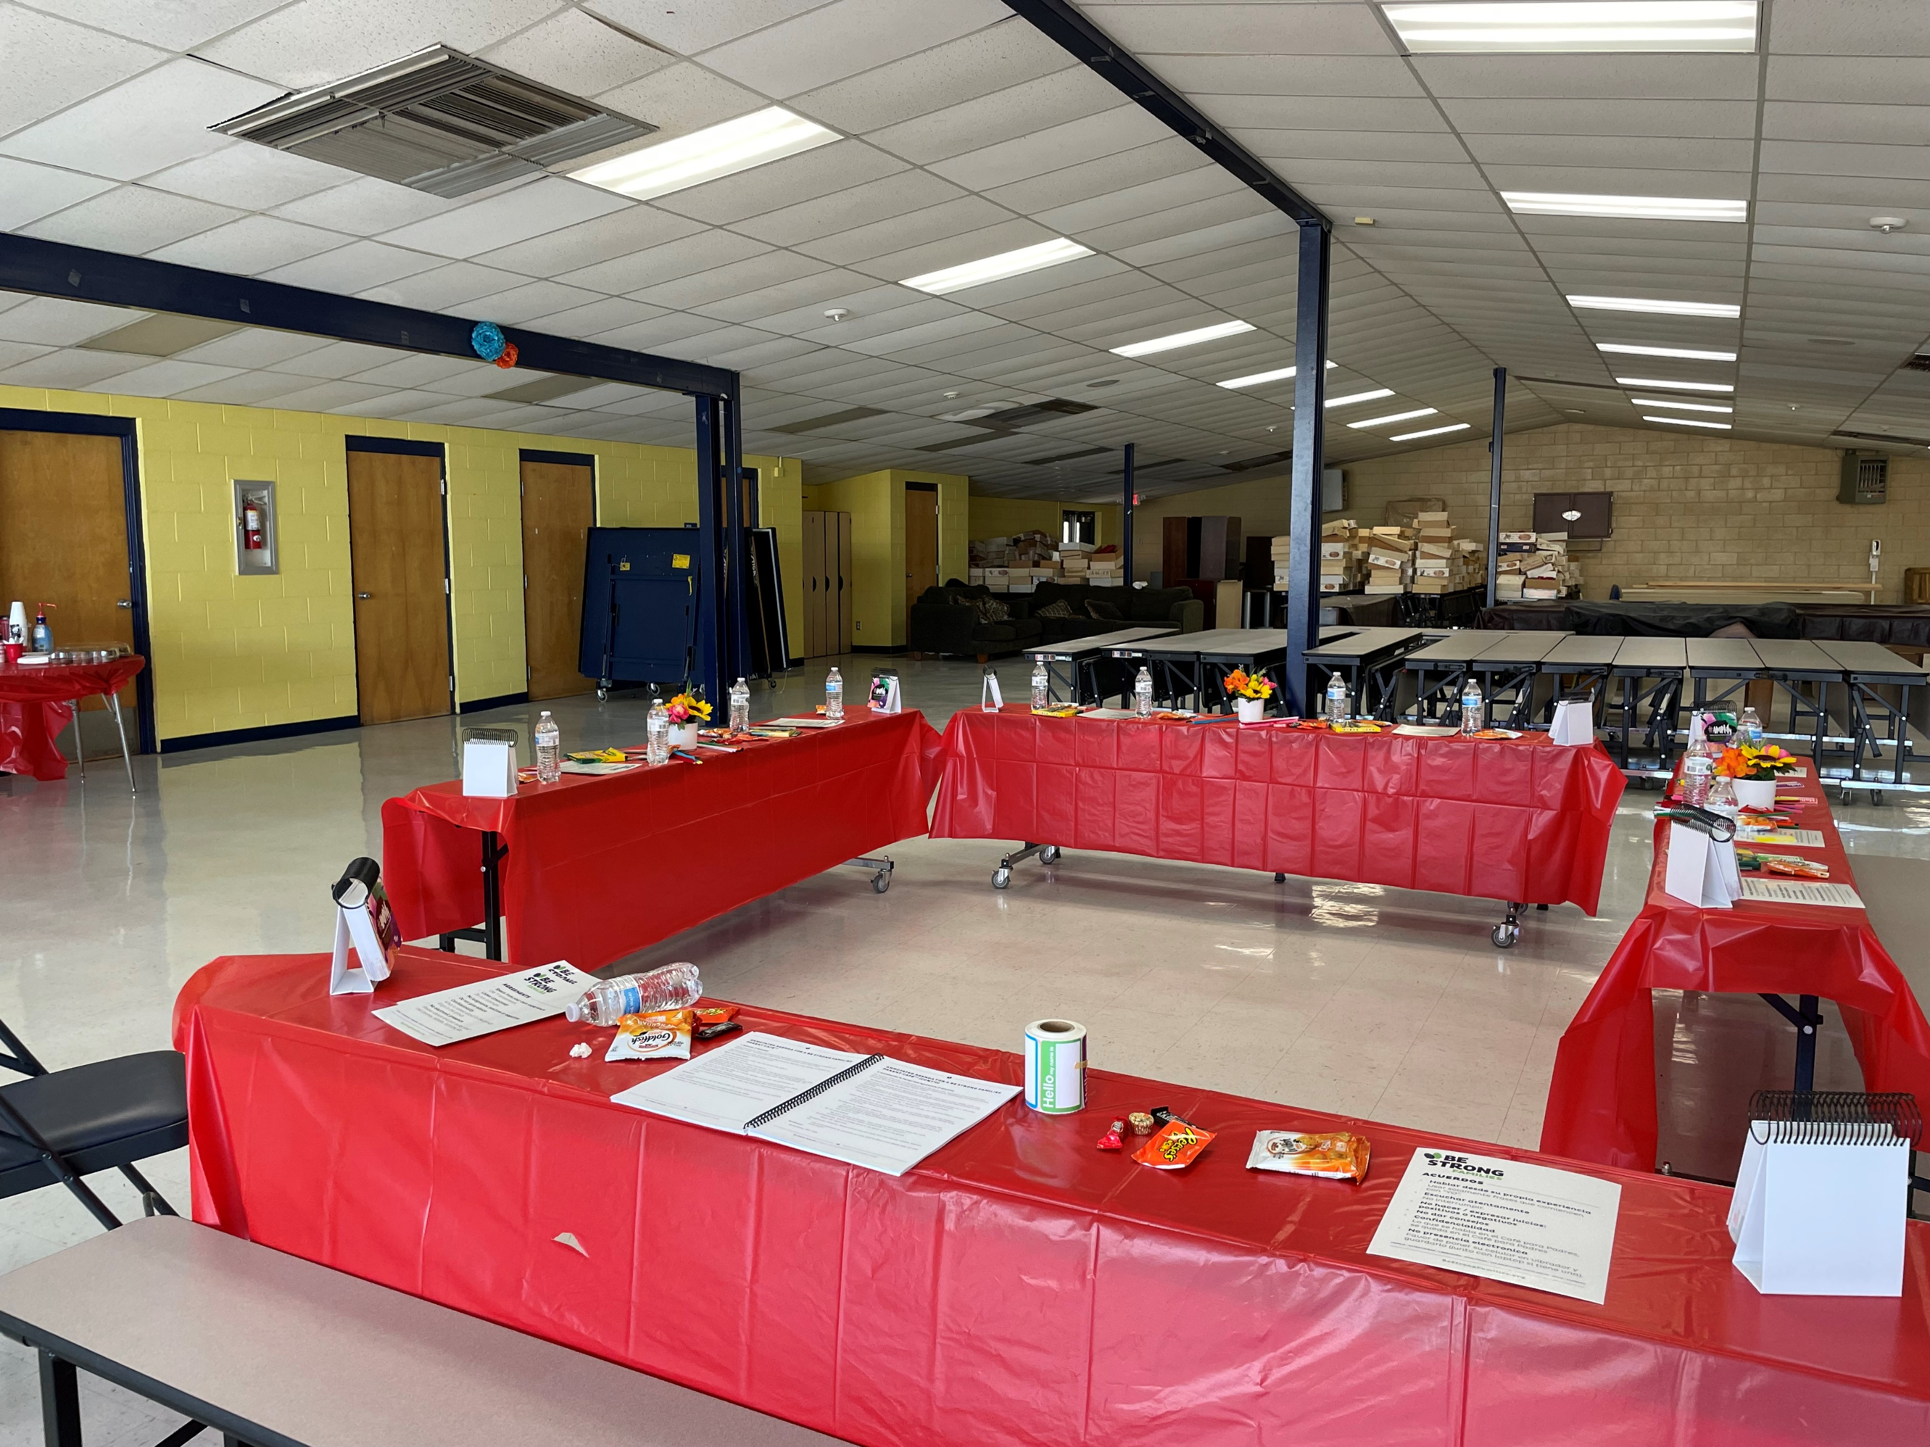
Parent Cafes cont.

Slide 23
TxSOC Family Partner

Slide 24
What is a family partner?
Family Partner is an experienced, trained primary caregiver (i.e., parent of an individual with a mental illness or serious emotional disturbance) who provides peer mentoring, education, and support to the caregivers of a child who is receiving mental health community services.

Slide 25
Family Partner
Family Partner services include:
Teaching caregivers how to advocate for their child’s needs
Linking families to community resources
Skills training to the caregiver using evidenced based practices such as Nurturing Parenting
Helping identify natural supports for the child and family
Services and interventions tailored specifically to the caregiver

Slide 26
Success Stories
Single dad recently divorced who felt lost and confused about how to be a parent in his new “single dad role”
Mother embarrassed and skeptical about receiving mental health services and supports
Mother unsure how to help meet her child’s mental health needs

Slide 27
Any questions?

Slide 28
THANK YOU!

