Slide 1
School Mental Health
Resources Database
ABC March Webinar | March 8th, 2023
Notes:
Hi everyone, I'm Chelsea Sorensen, an Education Project Specialist with the Region 14 Comprehensive Center out of Westat. I support our School Community Health portfolio of work across Texas, Louisiana and Arkansas. Our team at the Region 14 CC is assisting TEA with the continuous improvement of the School Mental Health Resources Inventory that was identified in Senate Bill 11 of the 86th Texas State Legislature. I’m here today to showcase the School Mental Health Resources Database that we launched last year to increase access to mental health resources across Texas.

Slide 2
Legislation Background
ESC Rubric + Inventory Feedback
Agenda
Continuous Improvement Goals
Implementation Progression
Demonstration
Panel
Notes:
Before I do the website demonstration, I’m going to walk through just a couple slides to provide a bit of background on the Database to set the stage for you and to give a bit of insight into why it was developed.

Slide 3
86th Texas Legislature | Senate Bill 11
Requirements
TEA to develop a rubric for ESCs to use in identifying resources related to student mental health
Available to schools in their respective regions.
Requires the agency to share the revised rubric with the ESCs by December 1 in each odd numbered year
Requires each ESC to submit a report on resources identified by March 1 in each even numbered year.

Slide 4
Senate Bill 11 Inventory Requirements
Develop a list of statewide resources available to school districts to address mental health of students, including:
Public + private funding sources
School-based programs
Community-based programs
Communities In Schools program service
Training + Technical Assistance
School-based mental health providers
Notes:
Additional requirements from SB 11 stated that:
​
From the resource rubric, TEA shall develop a list of statewide resources available to school districts to address mental health of students, including the following categories:​
*Animations*
Communities In Schools program services
training and technical assistance on practices that support the mental health of students; ​
school-based programs that provide prevention or intervention services to students; ​
community-based programs that provide school-based or school-connected prevention or intervention services to students; ​
school-based mental health providers; ​
and public and private funding sources available to address the mental health of students.

Slide 5
Challenges + Feedback on 2019/2020 Rubric
Feedback collected by TEA and Region 14 CC:
Static end-product
Staff turnover
Not user-friendly
Variable formatting and entry processes
No data validation
Notes:
In preparation for the release of the December 1st, 2021 revised rubric, the Region 14 CC and TEA collected feedback from ESCs on their use of the 2019/2020 rubric and found that the end product, which at that time was a static Excel document sent to each ESC, was not largely used by ESCs or anyone else, for that matter. Part of this was due to staff turnover. If the ESC person responsible for the rubric left, sometimes the new staff was unaware of the Excel document. Part of this was also impacted by an end product that was, in itself, not very dynamic and user friendly to the people who may want to access these resources.
In our review of the resources identified in the 2019-2020 rubric, the Region 14 CC and TEA spent a lot of time cleaning the data that was collected in these Excel documents, which created additional opportunities for inaccuracies and errors to be made. Some ESCs edited the format of the columns of the data so it was no longer uniform across the state. Others uploaded to Google Sheets to collaborate with others, which impacted the formatting of the data again when it was re-downloaded. There were no built-in data validation measures like requiring 10 digits for phone numbers or 5 digits for Zip codes. This left us with some questions about the quality of the data that was collected, knowing that there was a wide variance in collection and entry processes.

Slide 6
Continuous Improvement Goals: 2021/2022
Usability
of end product
Quality
of data
Direct data entry and a dynamic, searchable end product addresses both of these areas of improvement.
Notes:
Based on feedback collected by TEA and the Region 14 Comprehensive Center on the 2019/2020 version of the resource rubric and data collection process, our two major goals in continuous improvement for 2021/2022 were:
to address the quality of data ​using data validation and standardization to decrease entry errors and the need for extensive data-cleaning​; and
to address the usability of the end product​ by creating a direct data entry system and a dynamic, searchable database that is easily accessible to stakeholders.

Slide 7
Database
Implementation Progression
Data Entry Form
Public Website
Data Reports
Designed using statute requirements
ESC staff were be able to enter resources directly into the database
Built-in data validation increased accuracy of information entered
Public, searchable database available statewide as part of mental health ecosystem network
TEA + ESCs able to share database with schools, districts, policymakers, etc.
Data on the website is always up-to-date with ESC submissions
TEA able to run reports about resource availability to include in Statewide Mental Health Plan
Summary data visualizations on the website and available for download

Slide 8
Features:
Public Database Website​
April 2022
User-friendly, public, searchable database available statewide
ESCs, districts, schools able to share available resources with students and families
TEA able to run reports about resource availability to include in Statewide Mental Health Plan and share with stakeholders

Slide 9
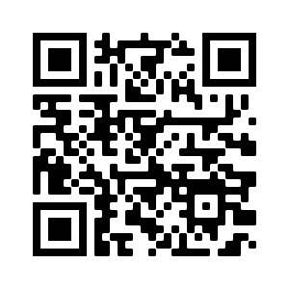
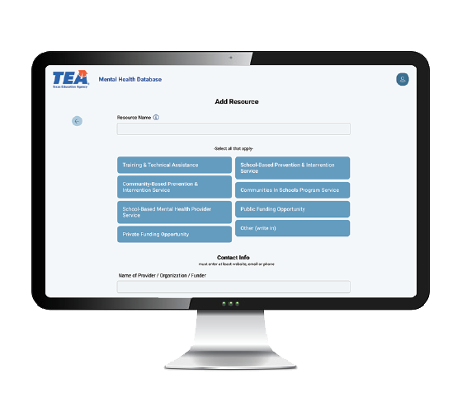
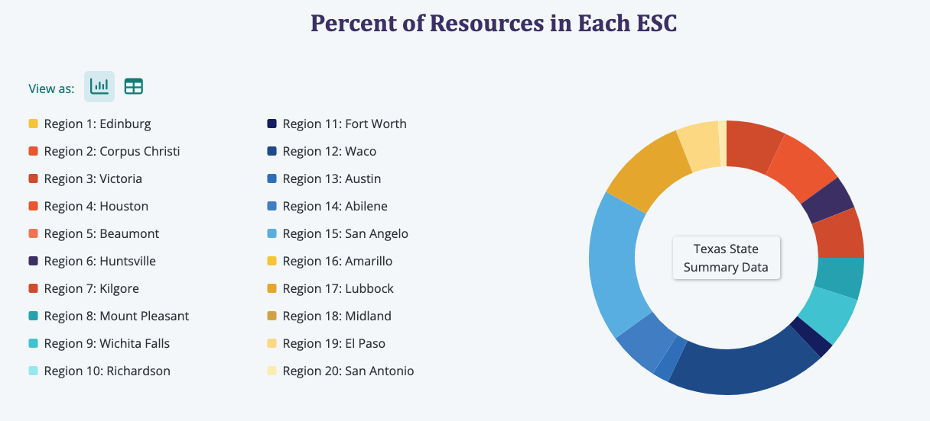
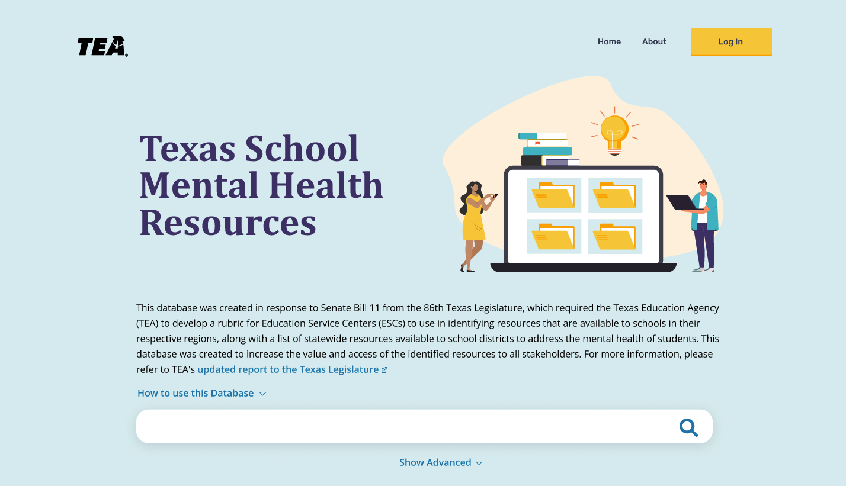
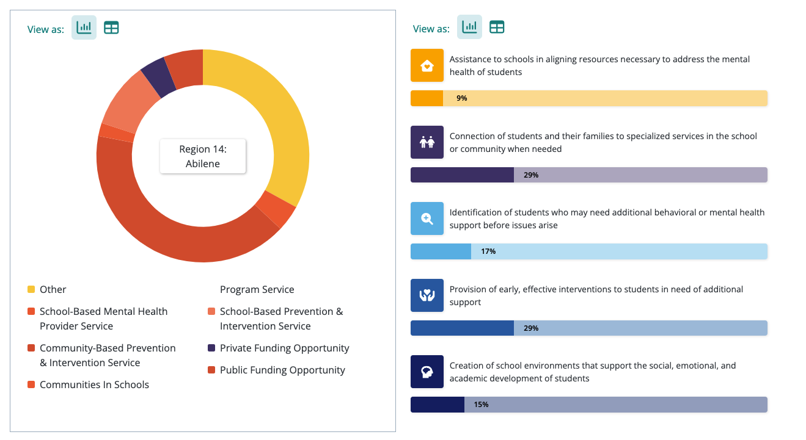
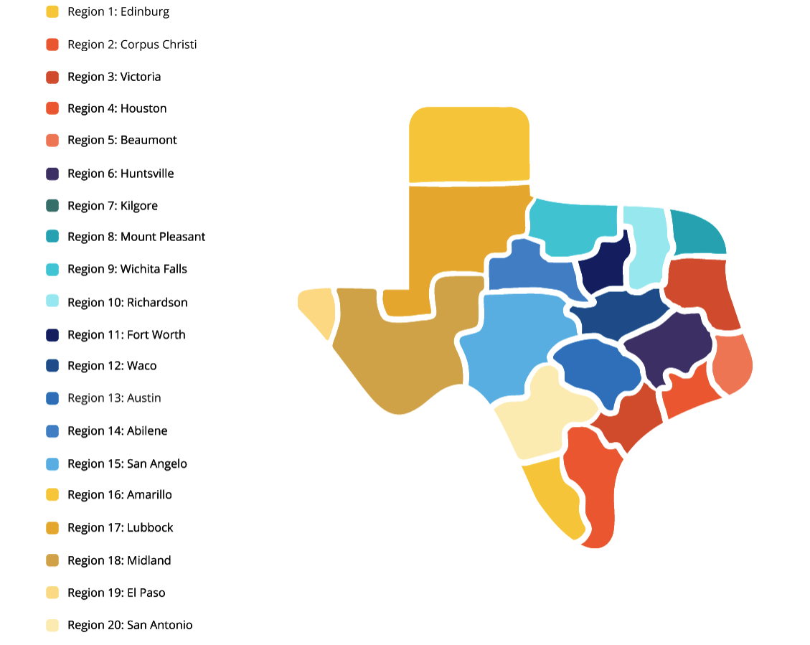
www.SchoolMentalHealthTXdatabase.org
Notes:
Screenshots taken from the website and QR code.
Using this new and improved process, we have identified 1375 total resources available to LEAs across Texas.
Anyone can access the website – ESCs, LEAs, families, policymakers, etc.
You can search for individual resources by keyword or location and gather contact information. Or you can view the summary data showing the total number of resources available by location or by intended impact. Resource tags include components of a comprehensive school mental health system.
Branding and design aligns with the Texas School Mental Health website.

Slide 10
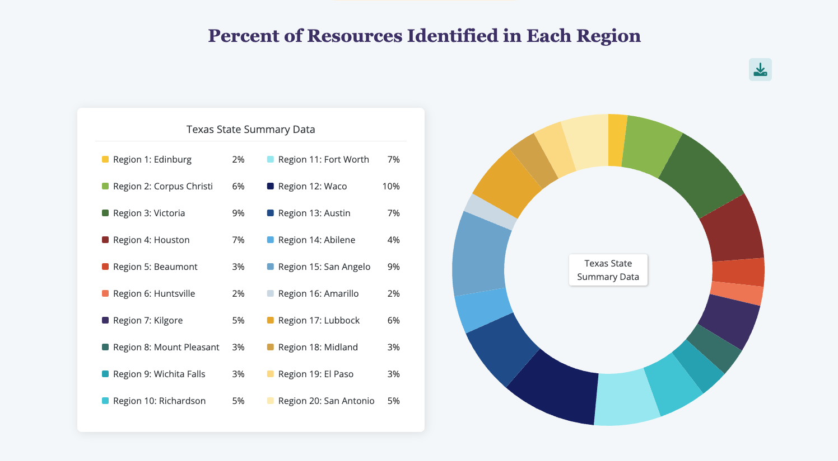
Resources by ESC Region

Slide 11
Testimonials & Use Cases
“We have had districts asking for community resources, so we share this database link with the LEA.”
“We share the database with grant districts constantly.”
“I had a Special Education Co-op Director asking about mental health resources for a student in one of her counties. I was able to show her how to use the search feature to find available local resources.”
Notes:
Last month we collected some testimonials from our ESC representatives at our PLC meeting and here are a couple quotes from regional mental health representatives on how they’re using the database.

Slide 12
Frequently Asked Questions
How do I get a resource added to the database?
On the About page, select your region on the map of Texas to be taken to your regional point of contact.
How does resource information get edited?
Each ESC has a point of contact who designates editing access to the resources for their region.
How many users does the database have?
Over 5,800 to date!

Slide 13
User Experience Panel
How do you interact with the database in your role?
Panel Discussion
How has the database addressed a need?
Can you share a story about how someone else has used the database?
How have you shared the database with others?
Advice for others using the database?

Slide 14
Closing
Thoughts? Questions?
Contact: ChelseaSorensen@westat.com
Notes:
I hope that you found this useful and hope this opens communication to your point of contact for mental health and school safety who can help us keep the database up to date with all of the available resources in your counties and districts. We want this to be a living database and one of the big benefits of putting it online is that it can be edited at any time by your ESC point of contact. So please reach out with any questions and thank you for your time.

