Slide 1
Community Resource Coordination Groups of Texas
Office of Mental Health Coordination
Texas Health and Human Services Commission
Notes:
will provide an overview of Community Resource Coordination Groups or CRCGs, including their function, a brief history, review the CRCG process, and the benefits of inter-agency coordination.

Slide 2
Community Resource Coordination Groups (CRCG) Basics
Notes:
CRCGs are county-based interagency coordination groups who work with parents, caregivers, children, youth, and adults with complex needs to identify and coordinate services and supports.
They help people whose needs can’t be met by one single agency and who would benefit from interagency coordination.
They strive to meet the person and family’s needs with community-based solutions whenever possible.

Slide 3
CRCG Basics (3 of 16)
Organizations
Individuals
& Families
Local Agencies
Individual Service Plan
(ISP)
Notes:
CRCGs are organized by the local community. CRCG members include local professional partners from public and private agencies and organizations who know about services in their community. Many CRCGs also include people who have been through the process before such as individuals, parents, or caregivers.
CRCGs host staffings to collaborate with individuals and families to:
Discuss their strengths, unique needs, previous services, and barriers.
Brainstorm ideas for appropriate services and supports.
Create individual service plans with recommendations for services and supports.
CRCGs bring together a wide array of people, allowing members to share resources and programs with one another, discuss organizational and community needs, and explore solutions.

Slide 4
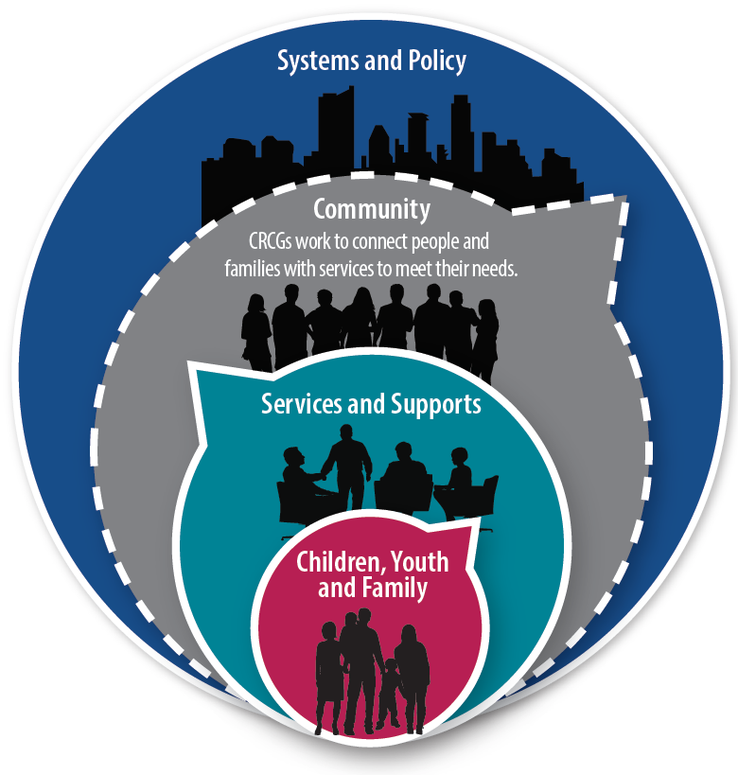
CRCG Basics (4 of 16)
Notes:
CRCGs can help align service providers and plans by bringing providers together and decreasing duplication of efforts.
Because CRCGs gather data and information about a variety of populations and needs, they are a great resource for larger systems such as systems of care, community coalitions, city councils, etc., to learn about gaps and barriers to services and supports throughout the community

Slide 5
Counties in Texas with CRCGs
Notes:
CRCGs serve people based on the community’s needs.
About 62% serve all ages either through one single CRCG that serves all ages or separate CRCGs that serve adults and then children and youth.

Slide 6
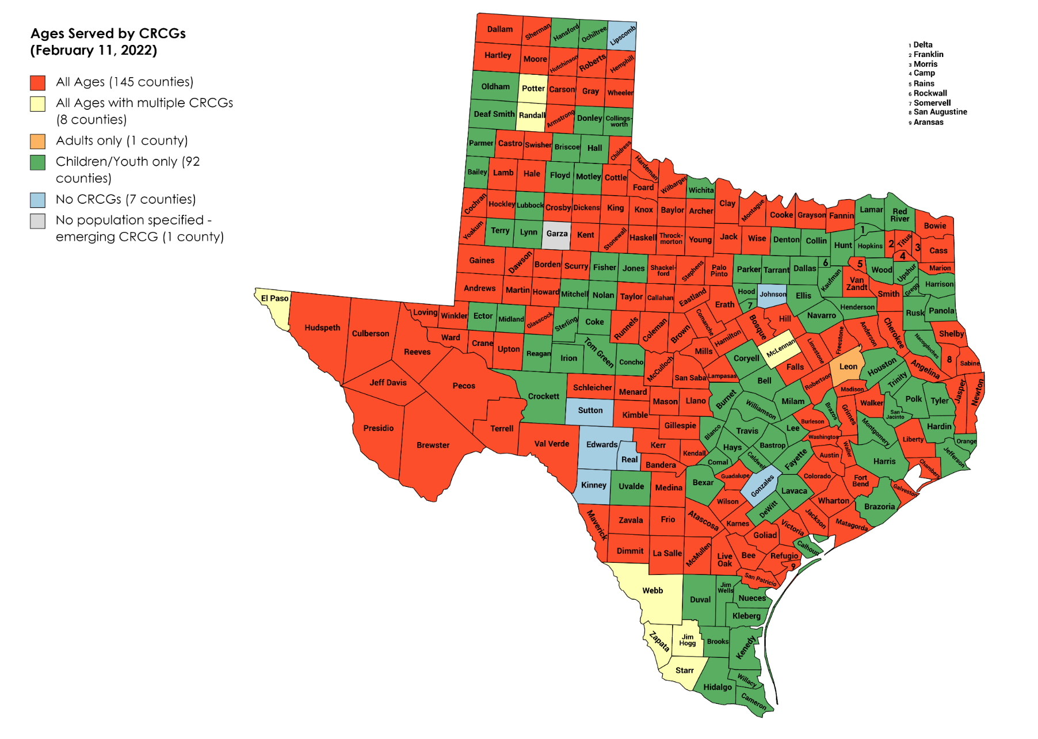
Counties in Texas with CRCGs by Ages Served
Notes:
CRCGs serve people based on the community’s needs.
About 62% serve all ages either through one single CRCG that serves all ages or separate CRCGs that serve adults and then children and youth.

Slide 7
CRCG Basics (7 of 16)
CRCGs
TEA
TJJD
DSHS
DFPS
HHSC
TWC
Texas Education Agency
Texas Workforce Commission
Texas Juvenile Justice Department
Texas Health and Human Services Commission
TDHCA
Texas Department of Housing and Community Affairs
Texas Department of Criminal Justice – Texas Correctional Office on Offenders with Medical or Mental Impairments
Texas Department of Family and Protective Services
TDCJ
TCOOMMI
Texas Department of State Health Services
Notes:
CRCGs were established by the Texas Legislature in the late 1980s to help bridge the gap for children with complex needs and to ensure agencies were coordinating. In 2000, CRCGs expanded to serve adults.
Eight state agency partners have agreed to support CRCGs through a memorandum of understanding (MOU), which was updated in 2018. The agencies include:
Texas Health and Human Services Commission (HHSC)
Texas Workforce Commission (TWC)
Texas Education Agency (TEA)
Texas Juvenile Justice Department (TJJD)
Texas Department of Housing and Community Affairs (TDHCA)
Texas Department of Criminal Justice (TDCJ) – Texas Correctional Office on Offenders with Medical or Mental Impairments (TCOOMMI)
Texas Department of State Health Services (DSHS)
Texas Department of Family and Protective Services (DFPS)
State agency partners support CRCGs at both a local and state level. At the local level, agencies have representatives participate in local CRCGs. At the state level, the agencies are part of the State CRCG Workgroup along community-based organizations and family and peer representatives, and this workgroup supports training initiatives for CRCGs.

Slide 8
Common CRCG Members
Local mental health authority (LMHA)
Local intellectual and developmental disability authority (LIDDA)
Local government service providers
Housing authority
Aging and disability resource center (ADRC)
Area agency on aging (AAA)
Peer and family representatives
Judges and judicial support offices
Probation and parole officers
Counseling and other behavioral health providers
Health care providers
Faith-based organizations
Community-serving organizations
Private sector stakeholders, such as managed care organizations
Child and adult protection representatives
Early childhood intervention services
School districts, education service centers, and school counselors
Notes:
This list of common CRCG members includes community based members as well as local affiliates of the mandated state agencies from the previous slide. Each CRCG determines who needs to be at the table to meet their community’s needs.

Slide 9
Eligibility Criteria
You need services that your agency can’t provide
You need multiple people to come together to help coordinate services
CRCG may be the right fit to meet your needs
Notes:
A CRCG meeting may be the right fit to meet a person’s needs if they meet the following criteria:
They are currently receiving or have received services in the past from at least one agency or organization, and
They need services the agency or organization can't provide, and
They need coordination of services between multiple agencies.

Slide 10
Who can refer?
Family or peer representative
Agency or organization
CRCG member
Notes:
Individuals and families are connected to CRCGs through referrals.
The referral may be submitted by a CRCG member, a local agency or community organization, and family or peer representatives. Individuals and families also have the option to self-refer.
Each CRCG may have a unique referral form, so please contact your local CRCG leader to request a form.

Slide 11
CRCG Staffing Process
Welcome and Introductions
The individual, family, or caregiver attends a staffing meeting with participating CRCG members.
Members will introduce themselves identifying what agency or services they represent.
Information Sharing
The individual, family, or caregiver will be invited to share what brought them to the meeting and what they need from the CRCG.
Build the ISP
Together, the CRCG, individual, family, or caregiver will identify services and supports that match their identified strengths and address their needs.
The CRCG, individual, family, or caregiver will review the services together and reach an agreement on the plan.
Members will ask questions to identify strengths, clarify needs, and increase their understanding of the circumstances.
Notes:
CRCGs typically meet on a monthly basis, and as needed when referrals with immediate needs are made. Often, when CRCGs don’t have a referral for that month, they will meet anyways to connect, share resources, invite presenters to share about their organization and services, and discuss needs of their community. If there are referrals for the month, this is typically what the staffing process looks like:
It begins with welcomes and introductions
The individual, family, or caregiver attends a staffing with participating CRCG members.
Members will introduce themselves identifying what agency or services they represent.
Next is information sharing
The individual, family, or caregiver will be invited to share what brought them to the meeting and what they need from the CRCG.
Members will ask questions to identify strengths, clarify needs, and increase their understanding of the circumstances. The CRCG will ask you to share:
What brought you to the meeting.
Types of services you received before, and how successful they were.
Your goals.
Your strengths and supports.
How the CRCG can help support you.
Lastly, the Individual Service Plan, or ISP, is built
Together, the CRCG, individual, family, or caregiver will identify services and supports that match their identified strengths and address their needs.
Based on this discussion, the recommendations will be listed in the ISP.
The CRCG, individual, family, or caregiver will review the services together and reach an agreement on the plan.

Slide 12
CRCG Basics (12 of 16)
Meet individuals’ needs
Keep people in the community
Keep families together
Identify gaps and barriers
Notes:
CRCGs benefit Texans by offering interagency coordination of services and supports, including basic needs, behavioral health, and caregiver support.
This approach allows more people to remain in their own homes and communities by addressing their needs proactively and reducing any duplication of effort. Through the coordinated support of a CRCG, more Texans can live with improved health and wellness.

Slide 13
State CRCG Office
Data: data system, biennial legislative report
Communications: marketing and communication materials, website
Training and technical assistance: ongoing and as requested or needed
System of care: system of care values and partnership with Texas System of Care
Notes:
The State CRCG Office is charged with supporting local CRCGs in partnership with state agency partners.
To do this we focus on four main areas: data, communications, training and TA, and SOC.
Data:
We have a data system in which every CRCG input local aggregate data. We utilize this data to help inform our training and TA. This data is also used to inform the Texas legislature, governor, and partner agencies of CRCG efforts and gaps and barriers throughout Texas.
This month our 2021 legislative report that we wrote with the Texas System of Care program and included data from our data system was published and will be available on our website next month.
Currently working to update our website to make more user friendly and accessible to people seeking help.
Communications:
Implement communications initiatives and create marketing materials to increase visibility of CRCGs at a state and local level.
Training and technical assistance:
Provide ongoing training: webinars (which are open to attend, sometimes we’ll highlight programs available statewide, or explore topics that people are interested in hearing about), bridge calls, training materials
One on one training and TA – in-person and virtual
During COVID 19 we have been supporting CRCGs in moving to virtual meetings. We’ve had a webinar to help address questions about process and confidentiality and allow time for CRCGs to share their experiences with each other. CRCGs have reported diverse feedback about hosting virtual meetings, but overall have been positive. We will continue to explore with CRCGs over the coming months how to move forward and continue to be flexible once we are back working in our communities.
System of Care (SOC):
Partner with Texas System of Care to help train CRCGs in best practices and infuse the SOC values of being:
Family driven
Youth guided and driven
Cultural and linguistically responsive
Community based

Slide 14
How to Support and Get Involved
Reach out to your local CRCG leaders. Ask how you can get involved.
Become a member or leader as appropriate.
Share CRCG information with families and refer when appropriate.
Attend staffings when making referrals and provide updates.
Train staff about CRCGs on regular basis.
Tell community leaders about the positive impact of CRCGs.
Notes:
There are many ways to support and get involved with your local CRCG:

Slide 15
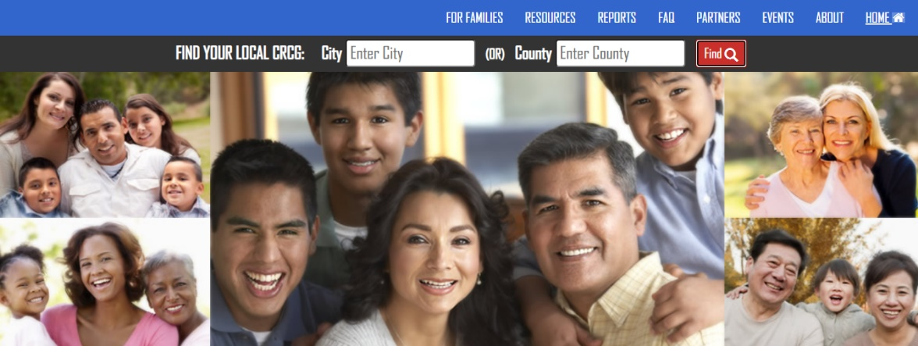
How to find your local CRCG
https://crcg.hhs.texas.gov/
Visit https://crcg.hhs.texas.gov/
Notes:
You can find your local CRCG by going to the website (https://crcg.hhs.texas.gov/) and searching by city or county.
Email or call your local CRCG leaders and let them know how you would like to support or participate with the CRCG,

Slide 16
Thank You! Julie Abreu, CRCG State Coordinator Office of Mental Health Coordination
(512) 206-5255
CRCG@hhsc.state.tx.us
https://crcg.hhs.texas.gov

