Slide 1
2022 Title IV Part A Small & Rural Capacity Grant Progress Report
Contributors: Ashton Millet, TEA School Mental Health and Wellness Team & Texas Institute for Excellence in Mental Health

Slide 2
About Small & Rural Grants through Title IV Part A
Intended to foster collaboration and reduce barriers in small and rural districts that lack capacity
Each region is responsible to partner with 5 or more LEAs to assess, build, and improve their mental/behavioral health system
Grant funds are provided to each of the 20 Education Service Centers to support small and rural districts with the delivery of:
Training
Coaching
Technical assistance
The Title IV A Grant’s focus on mental/behavioral health for small and rural LEAs has three overarching goals:
Provide all students access to a well-rounded education
Improve academic outcomes by supporting safe and healthy students
Improve the use of technology to advance student academic achievement (I.e. TCHATT)

Slide 3
Data Highlights-Key activities accomplished by ESCs
Local Education Agencies (LEAs) Served as of 2022 by ESC Region

Slide 4
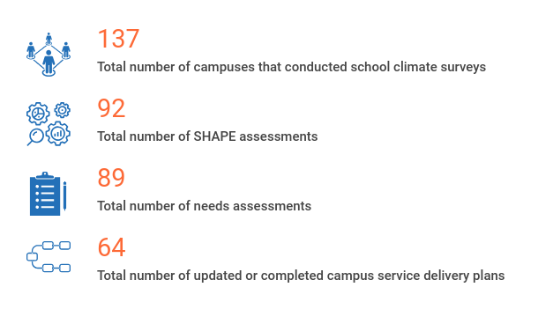
Data Highlights-Key activities accomplished by ESCs from Feb. 2021 – Feb. 2022

Slide 5
Data Highlights-Key activities accomplished by ESCs from Feb. 2021 – Feb. 2022
Note: Professional Learning Community (PLC)

Slide 6
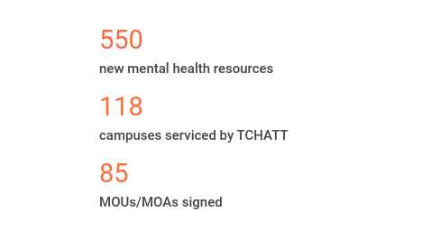
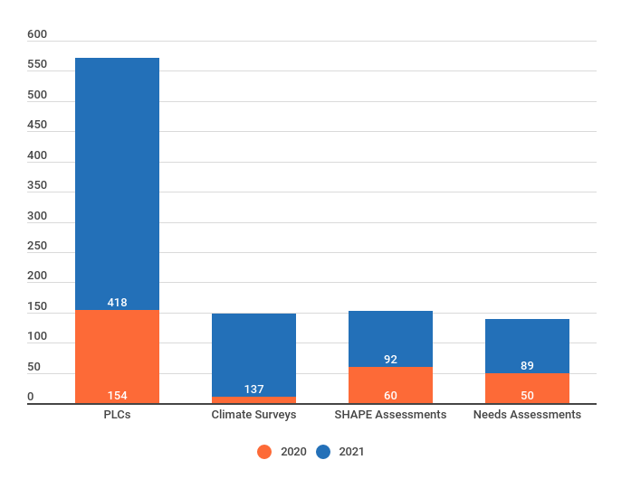
Data Highlights-Key activities accomplished by ESCs during Grant
Since the start of the Title IV Part A Small & Rural Capacity Building Grant
Note: Texas Child Health Access Through Telemedicine (TCHATT); Memorandum of Understanding (MOU); Memorandum of Agreement (MOA)

Slide 7
Opportunities for Improvement
Time
Turnover & staffing within LEAs
Teacher/Staff wellness
Culture & stigma around mental health
Distance from resources
Collaboration between ESCs/LEAs to share ideas & resources
Using mental health resource database
Managing staff mental health challenges to increase engagement and decrease stigma around mental health
Asynchronous on demand trainings
More Training of the Trainer (TOT) opportunities
Notes:
Solutions oriented. ESCs able to acknowledge the challenges but also discuss ways to address those challenges through learning opportunities.

Slide 8
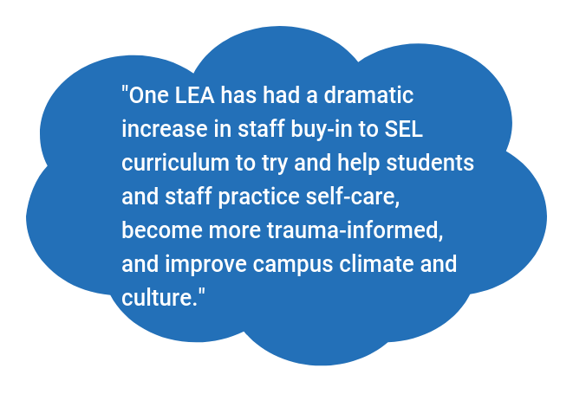
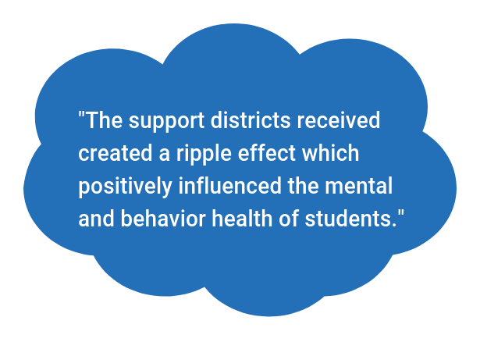
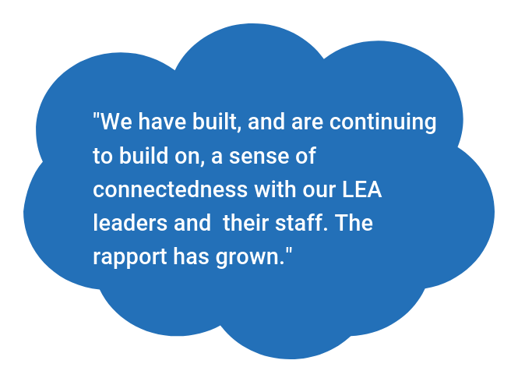
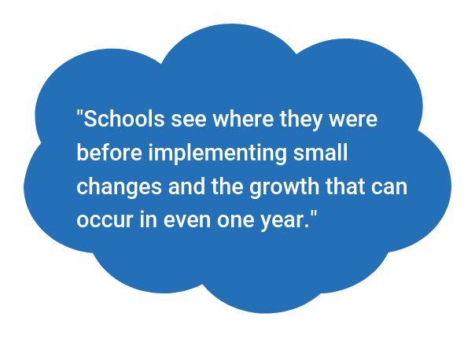
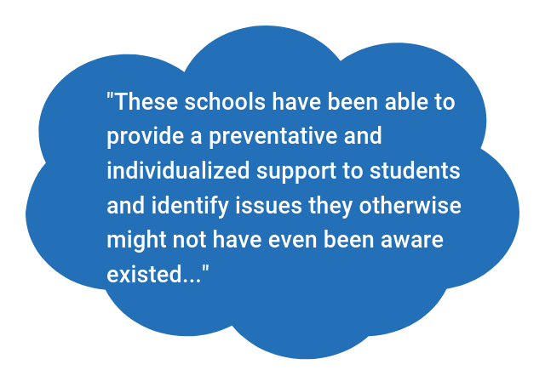
Highlights
Please share any highlights, stories, or celebrations from the LEAs or campuses receiving support from the Title IV Part A funds in your ESC region.

